Slide 1
Denial-of-Service Attacks

Slide 2
Denial-of-Service Attacks
A Denial-of-Service (DoS) attack is caused when an person intentionally attempts to disrupt or degrade services at a server, usually making that service unavailable to other users.
Early DoS attacks leveraged protocol weaknesses and were launched from a single attacking client.
Often, attacks weren’t noticed until clients complained about the lack of availability.
Firewalls and intrusion detection systems (IDS) or Intrusion Prevention Systems (IPS) are able to easily detect anomalies in traffic (both the amount of traffic, or the type of traffic) and can be configured to block the attacker’s IP address.
Notes:
Specific protocol weaknesses will be discussed later in the lecture. Assuming that normal traffic was baselined at the server, host-based and network-based IDS (Intrusion Detection Systems) could easily detect unusually large amounts of traffic being sent from a client. Too, where protocols were baselined, the transmission of unusual protocols to that server would trigger an alert. As an example, at an email server where normal protocols might include POP or IMAP and others, the sudden presence of a Telnet request would be flagged as anomalous. A Telnet request is sent to an email server by an attacker to force the server into responding with useful information about the software type and server version, called “banner grabbing” during reconnaissance.

Slide 3
Distributed Denial-of-Service
To elude detection, attackers soon used compromised workstations (originally called “zombies”, now “bots”) to attack from multiple sources. This is referred to as a “distributed” denial-of-service, or DDoS, attack.
A DDoS attack is much more difficult to defend against, not only due to the exponential increase in traffic, but because it may appear to be normal activity, deriving from multiple sources.

Slide 4
DoS and DDoS Mitigations
Most firewalls and IDSs can be configured to actively block IP addresses flagged for anomalous activity. Unfortunately, this can result in legitimate users being denied access as often the source IP addresses are spoofed.
Configuring the servers add additional RAM and CPUs, or clustering servers and using load balancers, can mitigate the impact of a DoS or DDoS.

Slide 5
Network Attacks

Slide 6
Network Attacks
The prevalent use of network protocols that were developed in the early days of networking present a number of vulnerabilities that can be exploited by a potential attacker.
Many of these vulnerabilities are due to the lack of authentication and integrity-checking capabilities.

Slide 7
TCP Vulnerabilities
Transmission Control Protocol (TCP) and Internet Protocol (IP) were originally developed in the early 70s.
TCP is responsible for the reliable end-to-end delivery of messages over the network.
IP is responsible for routing information from one network to another.
Attacking TCP/IP was simple. Attackers simply attack its basic functionality!
Notes:
While TCP is a “connection oriented” protocol, ensuring that all packets being communicated over the network are received, IP is a “connectionless”, or unreliable protocol and doesn’t track delivery of the packets at the destination.
TCP/IP was developed in an era of trust. There were no external hackers (there were no external connections, outside of dial-in users). As such, protocols trusted that the messages they received were from the systems they said they were from, and that the utilities and protocols would be used in a manner for which they were designed. No one envisioned that someone would want to “spoof” an IP address or otherwise misuse the protocol for malicious purposes. As such, attacks on the protocol leverage its inherent functionality.

Slide 8
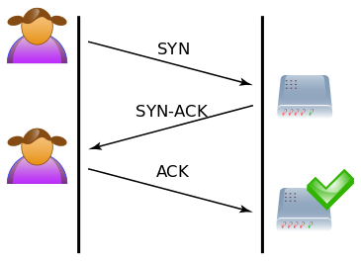
Normal TCP Handshake
When a user connects to a resource (e.g. Web server), the user’s system sends a TCP packet identified as a SYN.
When the server receives it, it allocates a connection for the user’s systems, sending back an acknowledgement (SYN-ACK)
The user completes the connection setup to access the data, sending an ACK to the server
Notes:
This photo is licensed under the Creative Commons Attribution-Share Alike 3.0 Unported license, located at https://commons.wikimedia.org/wiki/File:Tcp_normal.svg.

Slide 9
TCP SYN Flood Attack
Leveraging the three-way handshake that is performed at this initial connection, an attacker can overwhelm a server with connection requests.
Attacker sends TCP SYN packets to all ports at the server (i.e. Web server), using a spoofed IP address
The server responds to each request with a SYN/ACK, allocating a connection (each connection uses server RAM)
Since the attacker has spoofed the source IP address, the spoofed IPs receive the SYN/ACKs
After a while, the server runs out of connections (RAM) and other systems cannot connect until the server resets the connections
Notes:
This results in a Denial-of-Service (discussed later) at the Web server, and also negatively impacts the system with the IP address in the spoofed address. Windows systems will wait about 5 minutes before resetting the connection, freeing those resources up for use by another system.

Slide 10
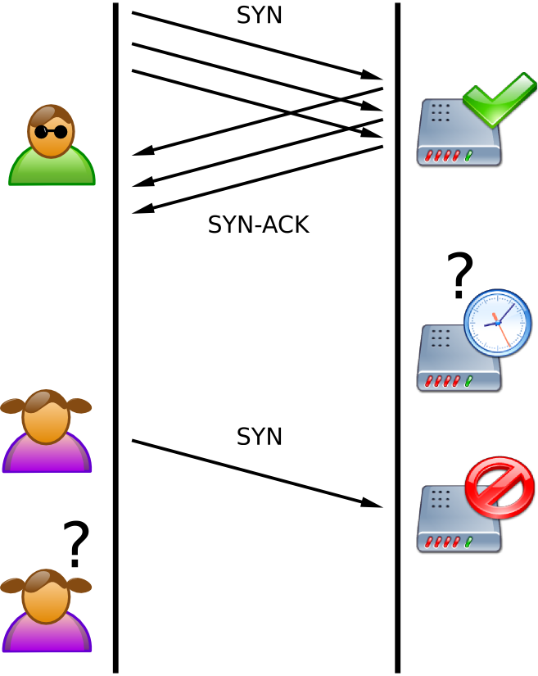
TCP/SYN FLOOD
In this depiction, SYN-ACKs go back to the attacker, tying up resources so that they are unavailable to others.
In more sophisticated attacks, the source IP is spoofed, and another victim receives the SYN-ACKs
CC BY-SA 2.5, https://commons.wikimedia.org/w/index.php?curid=810830
Notes:
CC BY-SA 2.5, https://commons.wikimedia.org/w/index.php?curid=810830

Slide 11
Mitigating TCP/SYN Floods
TCP/SYN floods can be easily identified by the large number of half-formed connection requests or unusually high numbers of connection resets (RST) that appear in sniffing tools, such as Wireshark.
Intrusion Detection/Prevention Systems can be configured to detect, and respond, to TCP SYN attacks.
TCP can also be configured at the server to wait less time before issuing a RST on a connection that has not responded to a SYN-ACK from the server.
During development, systems should be tested to determine if they have sufficient RAM and other resources to withstand a DDoS. This is often done by attacking the systems as the attacker would in a penetration test.
Notes:
Automatically blocking IP addresses at the firewall from suspected attackers can, unfortunately, also block legitimate users from connecting. This is due to the fact that source IP addresses in the attackers packets are usually spoofed.

Slide 12
ICMP
Internet Control Message Protocol (ICMP) is a messaging protocol for error and status messages on the networks.
ICMP Error Messages - reports error conditions
ICMP Queries - used to determine the status of a device (i.e. as with the ping utility)
ICMP vulnerabilities can be used in attacks against availability (DoS/DDoS), to covertly transmit information, and for reconnaissance purposes to gather information for an attack.

Slide 13
ICMP in a DoS/DDoS Attack
Very early DoS attacks leveraged the trusting nature of ICMP in their attacks. The earliest ICMP attacks consisted just of sending ICMP_ECHO (ping requests) to a server, which (if ICMP was enabled), had to respond with an ICMP_ECHOREPLY (the response).
Smurf is an example of an early ICMP DoS attack.
Attackers sent ICMP echo requests (ping) with spoofed source IP addresses to devices that would, in turn, broadcast the requests to all devices on the network. This would result in these devices responding to the victim’s IP.
Notes:
These initial attacks were very successful, as most servers at the time did not have sufficient memory or CPU resources. These were especially exhausted with DDoS’ where multiple systems were sending an overwhelming amount of ICMP_ECHOs to the server.
Attacks, such as Smurf, that send to incorrectly configured devices that broadcast the request to all devices on the network are referred to as “amplification” attacks.

Slide 14
ICMP in a DoS/DDoS Attack (Cont.)
Another way to “crash” a server, making it unavailable, using ICMP is to manipulate the ping packet, using a tool such as hping (now hping3), to increase the size of the ICMP packet beyond that allowed by the host (usually, 65536 octets). This is known as a “teardrop” attack.
Notes:
Hping is available at http://www.hping.org/ .
In normal communications, IP packets are fragmented, with each piece of the original packet containing the number of bytes contained in that segment. When the pieces reach the destination they are reassembled. In a teardrop attack, the attacker manipulates the size fields so that the segments overlap and can’t be reassembled. When the server crashes, it creates a denial-of-service.

Slide 15
ICMP for Covert Communications
“Covert communications” are communication channels that are established that allow unauthorized/unmonitored communications to occur.
Loki, named after the Norse God of deceit and trickery, is an attack that uses ICMP the option data section of an ICMP Echo packet, inserting and passing that is unmonitored if ICMP is allowed at the device.
Notes:
The attacker first gains administrator (root) access to a system, then setting it up as a Loki server (lokid). Next, the attacker launches a Loki client from the attacking system to create a reverse shell at the server in which to tunnel covert information via ICMP packets.
Using a network tool, such as Hping, makes it particularly easy to craft ICMP attacks.

Slide 16
ICMP as a Reconnaissance Tool
Reconnaissance is the process of gathering information about a potential target (victim) when planning an attack.
Using ICMP, we can gain information about the system, including: the number and type of devices (hosts) on the network, how the hosts are arranged (topology), what operating systems are loaded at the hosts, and the presence (and type) of a filtering device such as firewall or IDS/IPS.
Notes:
Much of this is possible as different operating systems implement ICMP differently, making the receipt of certain error messages under controlled conditions indicative of the operating system at that system.
Tools used to automate this process include nmap, Superscan, and other port scanning tools that use ICMP. As an example, sending a malformed packet to each protocol on a victim’s device will result in an ICMP Protocol Unreachable error message – indicating that that specific protocol is not supported at the server. The fact that the host responded provides information to the attacker that the IP address queried is attached to an active host.
Another method to fingerprint the operating system is to issue a ping request and look at the TTL. An ICMP reply containing a TTL of 128 indicates that it is a Windows system, while if the TTL is 64, it is a Linux system.
Traceroute is also another tool that uses ICMP and the TTL (Time to Live) value to allow the attacker to identify IP addresses associated with routers on the network. Other tools include Cheops and Firewalk.

Slide 17
Mitigating ICMP Attacks
Disallow all ICMP_ECHO traffic entirely. At a minimum, servers facing the Internet should have ICMP disabled.
Ensure that routers and other Layer 3 devices do not reply to broadcast addresses.
To prevent, or detect, covert channels, some firewalls can support analyzing the size of incoming ICMP packets to filter out ones that might contain covert messages, or ones that might crash the server.
Notes:
Often, internal servers require the use of ICMP to issue “keep alive” messages for routine health checks of servers on the networks.
Application firewalls do a deep packet analysis, reading into the data portions of the packets to look for these types of attacks. Too, the length of an ICMP echo request packet size is 42 bytes, with a data field length of 0. A firewall rule can be written to inspect the data field of these packets to determine if data has been present, at which point, the packet can be dropped.

Slide 18
Domain Name System (DNS)
The Domain Name System (DNS) server resolves friendly URLs and host names (computer names) to IP addresses.
DNS servers maintain a database (zone) of hostnames of systems to their associated IP addresses (resource records). What records they don’t store locally, are referred to a parent DNS server for resolution.
DNS is critical to the operation of a network. Without DNS, we would not communicate easily with any system outside of our own network – and, in some cases, not even with systems within our own network unless the IP address is known.

Slide 19
DNS Vulnerabilities
Attacks against DNS seek to either make the service unavailable (a DoS or DDoS), or “poison” DNS so that users are redirected to the attackers site.
Too, attackers can leverage vulnerabilities in DNS to gather information about the internal network, mapping the network to find devices to attack.
DNS cache servers can also be poisoned to redirect users to the attacker’s site.
Notes:
DNS

Slide 20
DNS DDoS Example
In October 2016, a massive botnet of Internet of Things (IoT) devices – consisting of webcams, DVRs, routers, etc., implemented a DDoS attack against Dyn – an Internet infrastructure company that provides DNS services to companies such as Twitter, Reddit, and others. The attack successfully degraded DNS services for much of the entire east coast of the United States for several hours.
The attack used malware called Mirai to infect the devices, then using tens of millions of IoT devices to overwhelm the victim’s DNS severs with up to 620 Gbps of traffic in the first few hours.
Notes:
The attack was largely attributed to the poor security of the IoT devices, where users had not changed default passwords.

Slide 21
DNS as the Attacker Distributed Reflection DoS (DrDoS)
An amplifying attack where DNS queries are sent to open DNS servers (resolvers), modifying the source address so that it spoofs the intended victim’s system.
These queries are designed so that the amount of information returned in the response is significantly larger than normal (64-byte versus 512-byte responses), overwhelming the victim’s system with traffic.
Notes:
The difference between this type of DoS and the previous example is that the previous attack sought to disable the DNS services itself. In this attack, it is designed to attack a different victim, using improperly configured DNS servers.

Slide 22
DNS
As a part of the reconnaissance phase, attackers will attempt to access DNS records to gain information on the IP schema and server IP addresses and names.
Servers that use older versions of BIND that are vulnerable to requests for “zone transfers” and will provide a copy of the DNS zone to the attacker.
Notes:
DNS servers transfer DNS records from a primary DNS server to the secondary DNS servers. This is due to information only being updated at the primary DNS.
Dig is a DNS attack tool for *nix based DNS that requests the records when attempting a zone transfer.

Slide 23
DNS Poisoning
DNS Poisoning, or hijacking occurs when a DNS server is modified by the attacker to respond to queries with bogus information (for instance, sending the user to a malicious banking site)
Common in some forms of phishing
DNS information can be poisoned at several locations where recursion/resolution occurs:
DNS Cache
Local hosts file
Local DNS server
Any additional DNS servers in the process

Slide 24
Mitigating DNS Attacks
Ensure that DNS servers are not providing recursion services outside of the local network.
Ensure that sufficient network bandwidth and RAM is built into the network and server design.
DNS servers should NOT provide caching services
Implement DNSSEC, which ensures the integrity of DNS queries by digitally signing requests – however this requires all DNS servers to install digital certificates.
Integrate DNS with Active Directory on Windows systems – negating the ability to do zone transfers as DNS data is now replicated through Active Directory replication.

Slide 25
Address Resolution Protocol
Address Resolution Protocol (ARP) – resolves known IP address to unknown Media Access Control (MAC) address via broadcast to network so that data can be delivered to a device on the local network.
ARP attacks are designed to either enable a DoS (where the device can’t be located), or poisoned, which can result in a man-in-the-middle (MITM) where the attacker can manipulate the contents of the data being transmitted.
ARP attacks are considered “insider attacks”, as the attacker has to be on the inside of the network, however an attacker that installs a Remote Access Trojan (RAT) to a device on the LAN is now local.

Slide 26
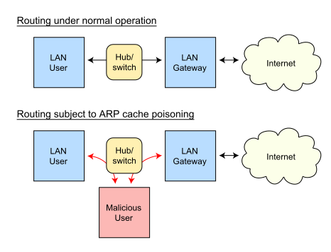
ARP Poisoning
ARP table poisoning (e.g. with Cain and Abel) results when the attacker sends spoofed ARP messages to a device on a network, such as a router.
Because ARP doesn’t verify the source of the packets, it accepts the packets and associates the attacker’s MAC address with the victim’s IP address. All packets sent to the router will now be sent to the attacker.
Attackers can now view (an attack on confidentiality) all packets, modify them and pass them on (integrity attack), or simply drop them (attack on availability).
Notes:
Image Source:
Retrieved from https://en.wikipedia.org/wiki/ARP_spoofing#/media/File:ARP_Spoofing.svg. https://creativecommons.org/licenses/by-sa/3.0/.

Slide 27
Mitigating ARP Attacks
ARP attacks are difficult to defend against due to the protocol’s inherent weakness of accepting what it receives as facts. There are several steps that can help to mitigate the likelihood of a successful ARP attack:
Disable unused ports
Implement port security at the switch
Use a switch that provides for Dynamic ARP Inspection to inspect ARP replies to ensure that they are authentic.
Notes:
DAI verifies all ARP requests to ensure that they are authentic.

Slide 28
Device Attacks
Hardware devices are not without their own vulnerabilities as devices such as monitoring and inspection devices such as switches, firewalls, and intrusion detection/prevention systems can be flooded with traffic, overwhelming them to cause them to either “fail open” (stop monitoring), or “fail closed”, where they prevent traffic from passing – resulting in a denial of service.
Remediation includes installing multiple devices (“clustering”) and load balancers.

Slide 29
Zero-Day Attacks
A zero-day attack exploits a vulnerability in a system that previously was not known – thereby providing “zero days of notice” to the attack.

