Slide 1
Just-In-Time Programming Knowledge: “Why can’t you write this program?”
Stephen Hughes, Coe College
J. Philip East, University of Norhtern Iowa
Notes:
I want to take the opportunity to talk about a technique that Philip and I have discovered, recognized ---- we think that it has a lot of potential. We call it just-in-time programming. It centers around repeatedly asking our students the question, “Why can’t you write THIS program? As it turns out this simple question has a lot of power behind it --- and I hope that you can take away from this talk some of that power to use in you classroom.

Slide 2
Designing a Programming Course
Programming
Language
Constructs
Problem Solving
Notes:
This started about two years back when Philip and I were talking about the design of a programming course. I believe that there are two major objectives when putting together a course --- we want students to learn about the specifics of writing code, but more broadly, we want them to use programming as a way engage in problem solving. Philip observed that he thinks that most students DO problem solving --- and even use conditionals and repetition in their reasoning --- but they often lack the ability to articulate the process of problem solving --- which is critical to successful programming. So we set out to design a course that explicitly put an emphasis on PS as a distinct part of programming.
Of course we all emphasize PS in our instruction, right? Well, yes and no… I think that in a programming course, we tend to focus on production of code as the ultimate benchmark for success. However, this isn’t always the main obstacle. Let me try to demonstrate

Slide 3
“Why can’t you write this program?”
The forecast says that it is going to be cold and windy tomorrow --- the low temperature is only 16°. I wonder what the wind chill is…
Notes:
So here is a scenario --- a set up for a programming assignment.
As seasoned programmers – I’m sure that most of you would answer that you Could in fact write this program. But I’m going to ask you to put yourself in the place of your students and think about what could go wrong….
We have identified several common responses to this question? That is, when challenged: why can’t you write this program – student responses can be categorized. Here is what we have observed.

Slide 4
“I don’t understand the problem well enough to know what is supposed to happen”
Notes:
This guy is just confused and doesn’t really know what to make of the problem statement. And I will admit that the problem statement was pretty vague -- Perhaps there is terminology that is not clear (Wind Chill) --- perhaps the overall objective is not easily understood by the audience.
Truth be told, the vagueness was kind of deliberate. If the objective is to strictly teach program features, we probably would do better to offer a sterilized complete, unambiguous problem statement --- but: this is not reality. And even if we try, we may not get there for all students --- Our approach is to embrace this confusion --- anticipate it and confront it….

Slide 5
“I don’t know how to represent or frame the problem in a way that allows me to clearly articulate a solution”
Notes:
That is only one of the ways that students may encounter obstacles. If the students understand what wind chill is, and that the problem is asking them to produce it – there can still be some confusion about where it comes from. What approach do I need to take to get there --- Is this a derived value? Am I looking it up? Another step in solving the problem is to think about the general steps that need to be taken. Can I classify this problem in terms of the kinds of techniques that I may use in solving the problem: Table-Lookup, Arithmetic --- dealing with single values, multiple values, there are conditions or exceptions involved. This is an iterative process.

Slide 6
“I generally understand the problem and I think I have an approach, but I am lacking some domain knowledge to fully solve this problem”
Notes:
This next one is kind of similar, but I think it is distinct enough. It is a bit more refined…. I may understand the general process, but I can’t write the program if I don’t know the details.
So I may suspect that there is a formula out there to compute Wind Chill, but I don’t know it off the top of my head. I vaguely remember the conversion between F and C (and I have done it enough that I can figure it out) --- but for this one I have no clue. As an instructor, I could be nice and provide the formula – but I would argue that in formulas rarely come packaged with problem statements in the real world. I am trying to teach about programming, not coding.
Making the students responsible for looking up the conversion is a powerful part of understanding the problem better. In the context of this problem, we will realize that my problem statement is missing some critical information --- to compute wind chill, you also need to know the wind speed. Again, that might be obvious to us, or at least you probably suspected it --- but this kind of discovery happens all the time.
Ok – so now we understand the problem, we understand the process and we know the formula --- now everyone can write this program…. Right?

Slide 7
I can solve this problem myself, but I can’t express this in a programming language
Notes:
I forgot to mention… We called this process “Just-in-time” for a reason.
Imagine that this problem was given immediately after “Hello World”.
This forces students to contemplate the gaps between their ability to describe a solution and their current level of programming knowledge. When they see a need for a particular kind of manipulation or operation, we can provide the language specific features that translate a natural language description into a coding solution.
This becomes particularly powerful once students start to have a base of knowledge.. I want to accomplish X --- how can I do that with what I know…. Maybe I need to learn something more.

Slide 8
I can write this program!
Notes:
And finally – we think that it is valuable to ask this question even when students DO have the ability to solve a particular problem. It underscores that they do know quite a bit and can accomplish – perhaps – more than they think

Slide 9
“Why can’t you write this program?”
Don’t understand the problem
Programming Constructs
Problem Representation
I Can!
Domain Knowledge
Notes:
So this simple Question, asked repeatedly, is incredibly powerful
As instructors
We should anticipate these responses occurring naturally and be prepared to deal with what our students are thinking
We should design our instruction to elicit each of these responses – they are a natural part of the programming process
When students encounter difficulty, we should ask them this question and base further assistance on their answers and suggested activity
Thus, we instill in our students a process that they can use on their own when solving programming problems. This question provides an alternative to banging one’s head against the wall of not-knowing-what-to-do-next.
Some additional problem examples with some sample Question responses follows.

Slide 10
“Why can’t you write this program?”
I want to conduct a 10-question survey using a Likert scale for each question. When a participant gives an extreme answer, they should be prompted to provide more detail
Notes:
Here is a problem statement that clearly deals with conditional thinking.

Slide 11
“Why can’t you write this program?”
Don’t understand the problem
Programming Constructs
Problem Representation
I Can!
Domain Knowledge
Notes:
Some potential student responses to the Question are shown below:
Don’t Understand:
What is a Likert Scale?
What is an Extreme value?
Problem representation:
Where do the questions come from?
What kind of additional detail is desired.
What is to be done with the results?
Domain knowledge
How many points on the scale?
Programming Constructs
Input widgets
Sequence vs Repetion problem
Files?

Slide 12
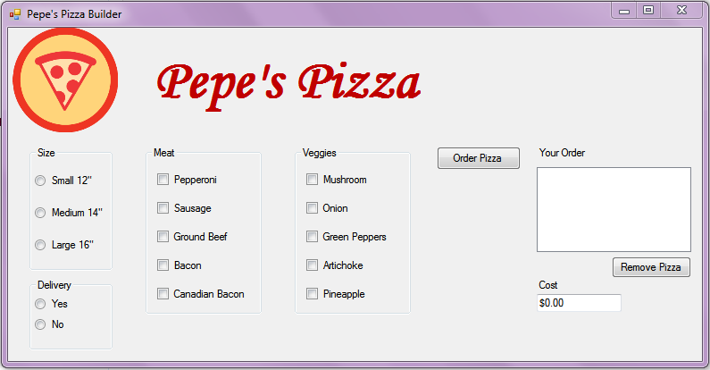
“Why can’t you write this program?”
Notes:
After providing students with the interface, ask them to produce a working app. Some potential student responses to the Question are shown below:
Don’t Understand:
What tasks are associated with the various widgets?
What shows up in the “order” box?
Problem representation:
How is pricing determined?
Should cost include tax?
What if they don’t check something?
Domain knowledge
?
Programming Constructs
How do I figure out what is checked?
How can I remember/store multiple pizza?
How can I remove a pizza?
Files?
Graphical description of the problem --- start with the interface; describe what it does. Why can’t you write this?
Extra assignment --- existing software interface

Slide 13
“Why can’t you write this program?”
Convert meters to feet
Convert base-10 to binary
Notes:
Talk this one through with your neighbors.
What problems would your students experience?
What might you use this example to teach?

Slide 14
“Why can’t you write this program?”
Determine Password Strength
Notes:
Talk this one through with your neighbors.
What problems would your students experience?
What might you use this example to teach?

Slide 15
“Why can’t you write this program?”
Don’t understand the problem
Requirements Gathering
Problem Representation
Algorithmic thinking; problem decomposition
Domain Knowledge
Real world problems require research
Notes:
The response to each answer of the question will determine what happens next. So does the context, i.e., who is asking the question.
If the teacher is asking the question and the students says, I don’t understand the problem, the teacher can indicate that what is needed is requirements gathering, i.e., seeking more information about the problem. The teacher can suggest that the student needs to ask the problem poser, questions about the problem. Questions like those noted above.
If the student indicates that they think they understand what is desired but don’t know how to start, the teacher can respond with questions about the steps that make up a solution, e.g., What will the answer (or end result) look like? What is necessary to produce that result? For each of the necessary elements, how can you determine/accomplish that result? What data will be needed (for the problem or a subproblem)? What operations/manipulation of the data will be needed?
If the student recognizes the needed tasks but doesn’t know the data or manipulations needed or doesn’t know the process used to accomplish the task, the teacher can point the student to the needed information or suggest a search process or …

Slide 16
“Why can’t you write this program?”
Programming Constructs
New Language Features
Build (or deflate) confidence
I Can!
Notes:
When students what needs to be done but not how to do it (or do it efficiently or in the indicated manner) in code, the teacher can:
Ask the student to review known language features
Suggest a review of some recent learning activity/example
Simplly tell the student what to use
When students think they’ve got it, have them code and test their solution. Ask:
Does it work?
How they know it works?
Have they considered all possible cases?
What happens if they get bad data values?
Perhaps indicate some situation for which you wonder if their solution works.

Slide 17
“Why can’t you write this program?”
Don’t understand the problem
Programming Constructs
Problem Representation
I Can!
Domain Knowledge
Notes:
The response to each answer of the question will determine what happens next. So does the context, i.e., who is asking the Question.
Teachers can use the Question
When introducing programming, to describe the process
When presenting examples of new kinds of data, data storages, data operations, language construct, algorithmics approach, etc.
When students are having difficulty and ask for help
Doing so will ingrain the question and it utility in the students’ minds, providing programming meta-knowledge they can use when the teacher is not around.

