Slide 1
Chapter 2
Computer Organization and Architecture: Themes and Variations, 1st Edition Clements
Computer Arithmetic and Digital Logic

Slide 2
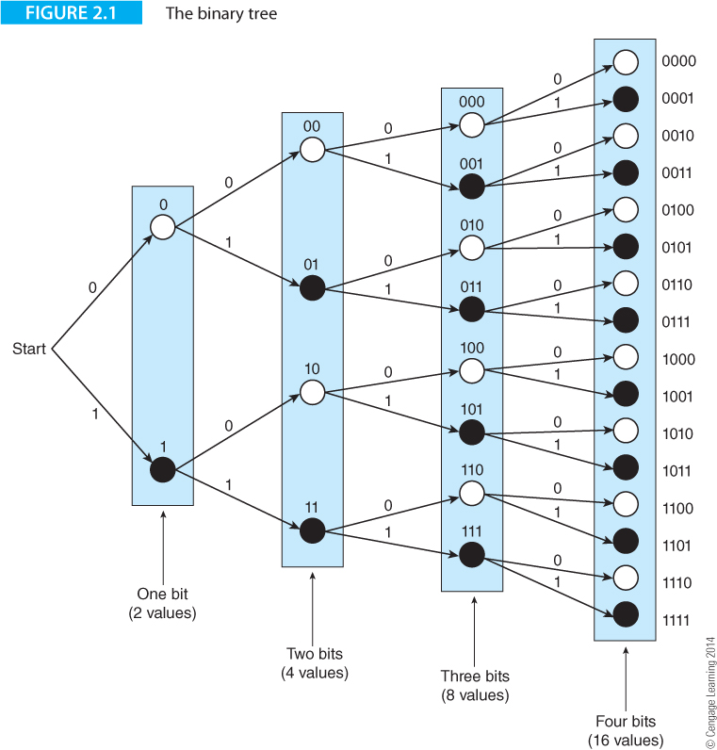
Computer Organization and Architecture: Themes and Variations, 1st Edition Clements

Slide 3
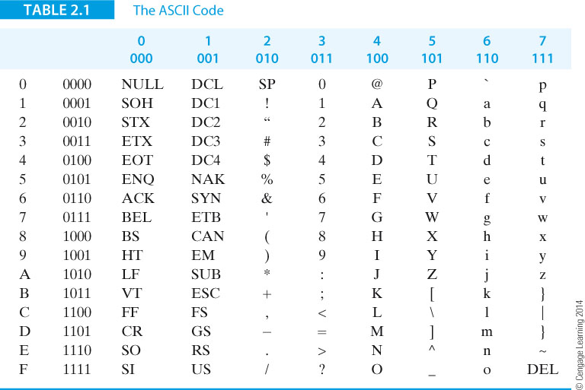
Computer Organization and Architecture: Themes and Variations, 1st Edition Clements

Slide 4
Computer Organization and Architecture: Themes and Variations, 1st Edition Clements

Slide 5
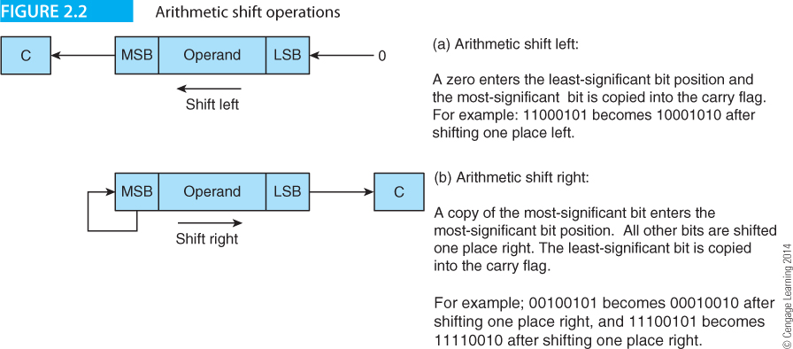
Computer Organization and Architecture: Themes and Variations, 1st Edition Clements

Slide 6
Computer Organization and Architecture: Themes and Variations, 1st Edition Clements

Slide 7
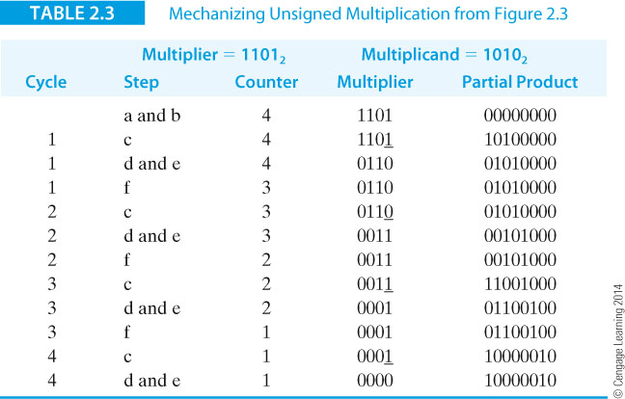
Computer Organization and Architecture: Themes and Variations, 1st Edition Clements

Slide 8
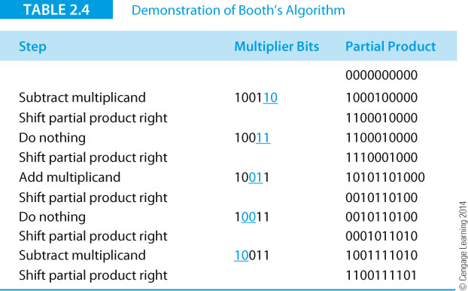
Computer Organization and Architecture: Themes and Variations, 1st Edition Clements

Slide 9
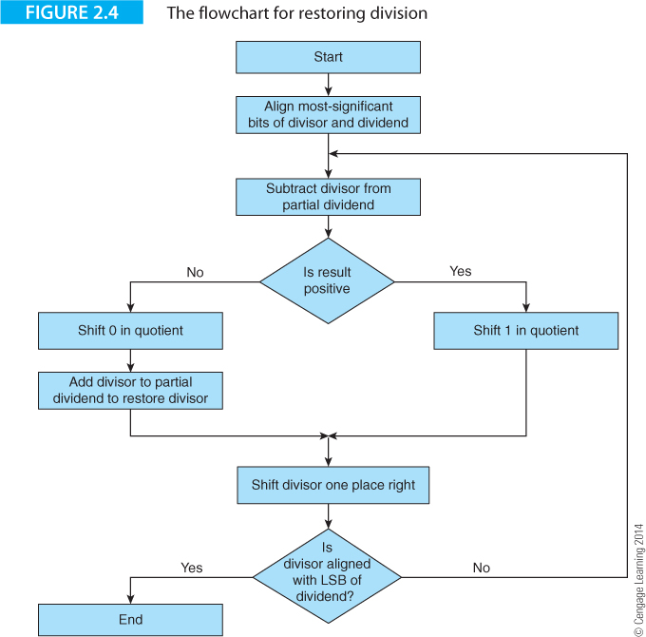
Computer Organization and Architecture: Themes and Variations, 1st Edition Clements

Slide 10
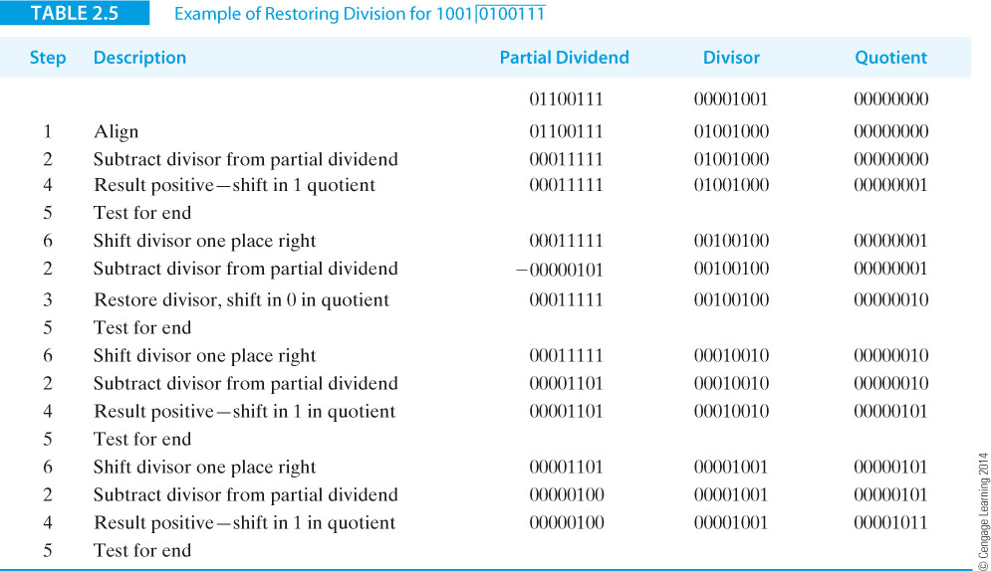
Computer Organization and Architecture: Themes and Variations, 1st Edition Clements

Slide 11
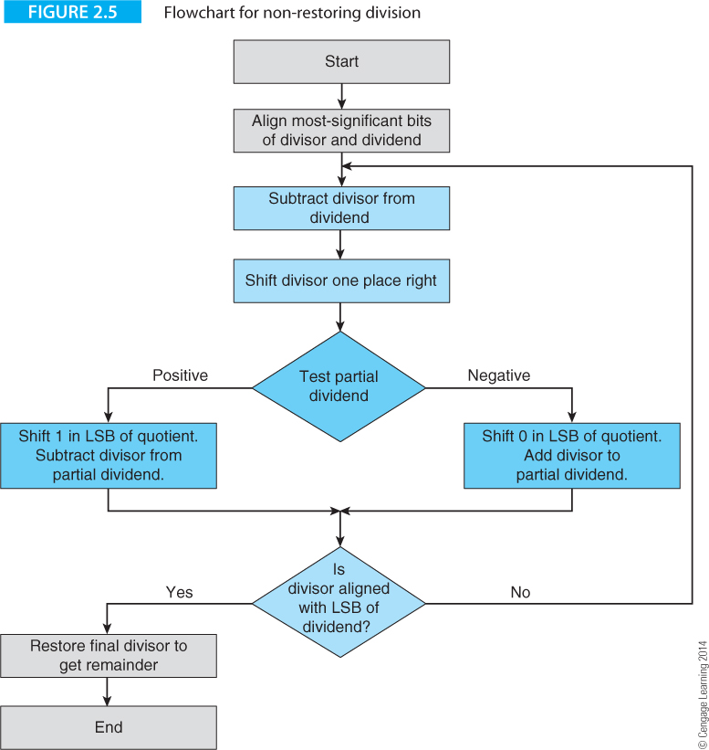
Computer Organization and Architecture: Themes and Variations, 1st Edition Clements

Slide 12
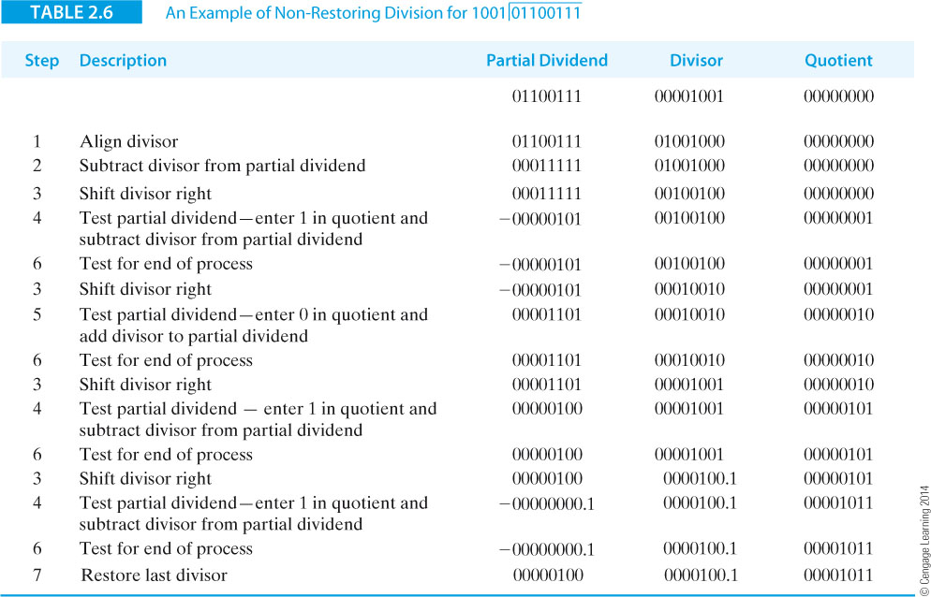
Computer Organization and Architecture: Themes and Variations, 1st Edition Clements

Slide 13
Computer Organization and Architecture: Themes and Variations, 1st Edition Clements

Slide 14
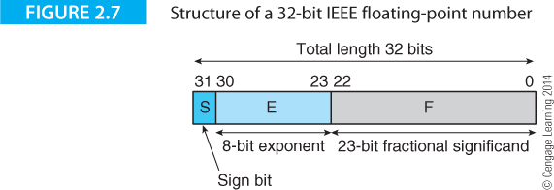
Computer Organization and Architecture: Themes and Variations, 1st Edition Clements

Slide 15
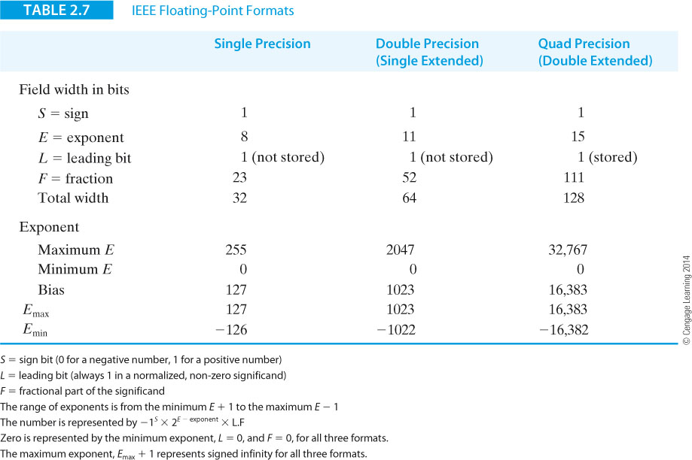
Computer Organization and Architecture: Themes and Variations, 1st Edition Clements

Slide 16
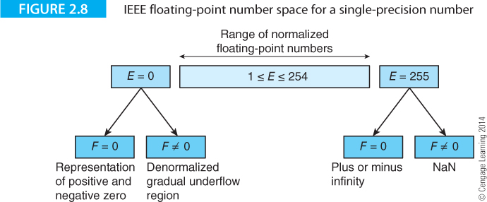
Computer Organization and Architecture: Themes and Variations, 1st Edition Clements

Slide 17
Computer Organization and Architecture: Themes and Variations, 1st Edition Clements

Slide 18
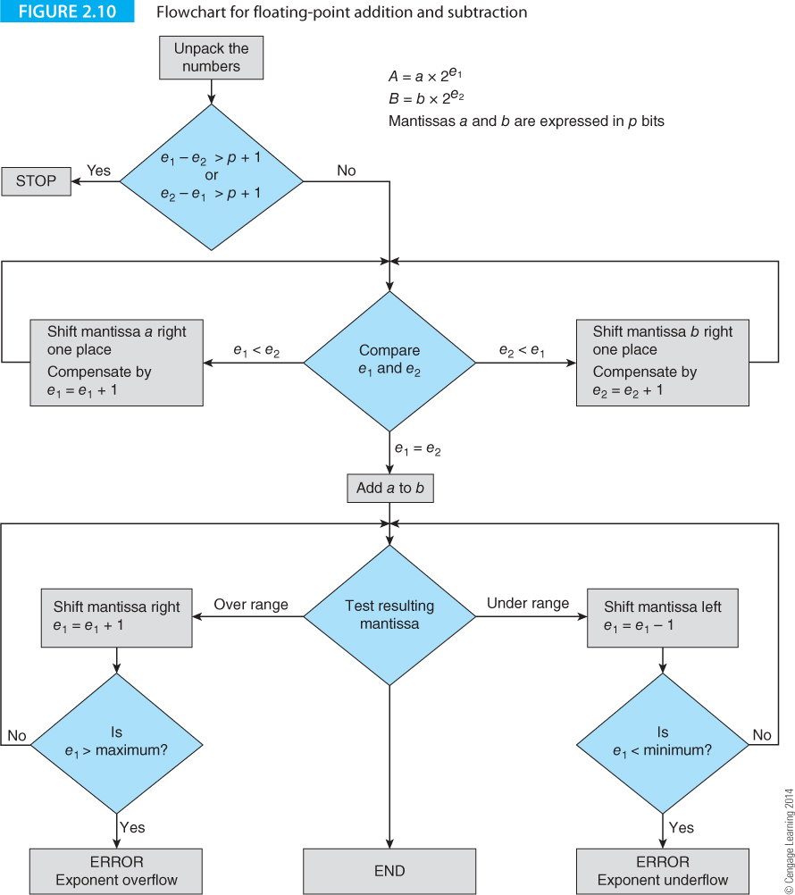
Computer Organization and Architecture: Themes and Variations, 1st Edition Clements

Slide 19
Computer Organization and Architecture: Themes and Variations, 1st Edition Clements

Slide 20
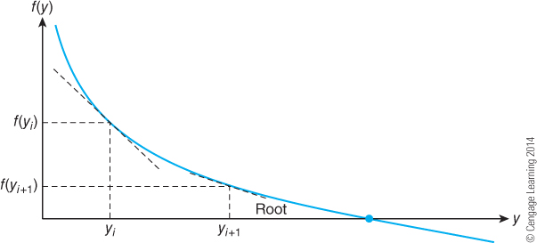
Computer Organization and Architecture: Themes and Variations, 1st Edition Clements

Slide 21
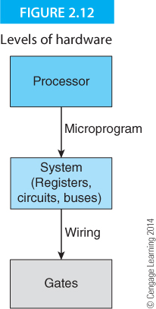
Computer Organization and Architecture: Themes and Variations, 1st Edition Clements

Slide 22
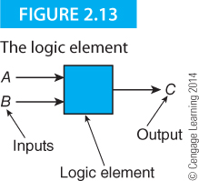
Computer Organization and Architecture: Themes and Variations, 1st Edition Clements

Slide 23
Computer Organization and Architecture: Themes and Variations, 1st Edition Clements

Slide 24
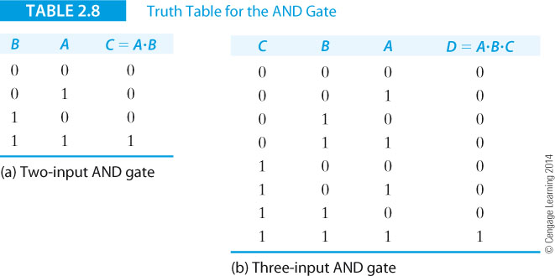
Computer Organization and Architecture: Themes and Variations, 1st Edition Clements

Slide 25
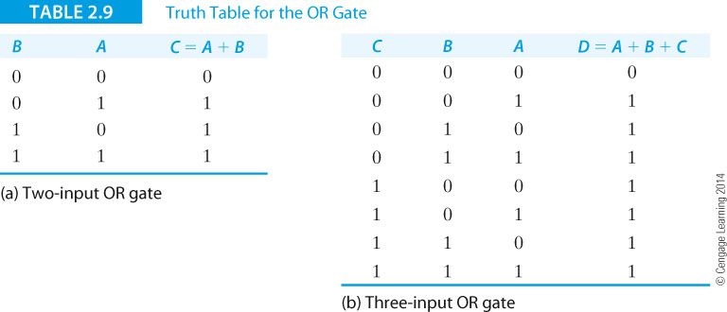
Computer Organization and Architecture: Themes and Variations, 1st Edition Clements

Slide 26
Computer Organization and Architecture: Themes and Variations, 1st Edition Clements

Slide 27
Computer Organization and Architecture: Themes and Variations, 1st Edition Clements

Slide 28
Computer Organization and Architecture: Themes and Variations, 1st Edition Clements

Slide 29
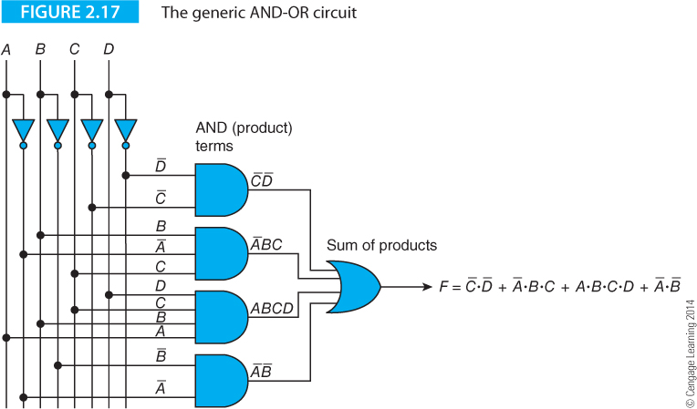
Computer Organization and Architecture: Themes and Variations, 1st Edition Clements

Slide 30
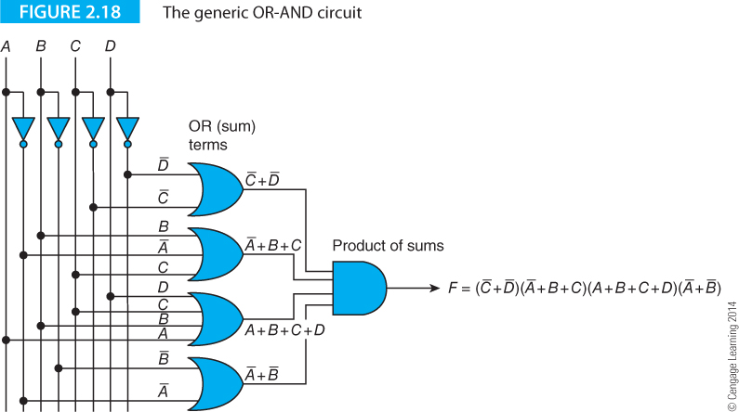
Computer Organization and Architecture: Themes and Variations, 1st Edition Clements

Slide 31
Computer Organization and Architecture: Themes and Variations, 1st Edition Clements

Slide 32
Computer Organization and Architecture: Themes and Variations, 1st Edition Clements

Slide 33
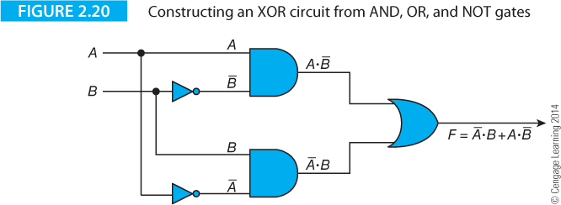
Computer Organization and Architecture: Themes and Variations, 1st Edition Clements

Slide 34
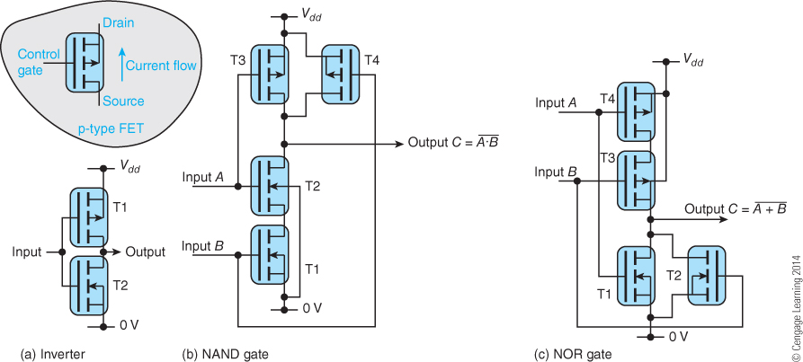
Computer Organization and Architecture: Themes and Variations, 1st Edition Clements

Slide 35
Computer Organization and Architecture: Themes and Variations, 1st Edition Clements

Slide 36
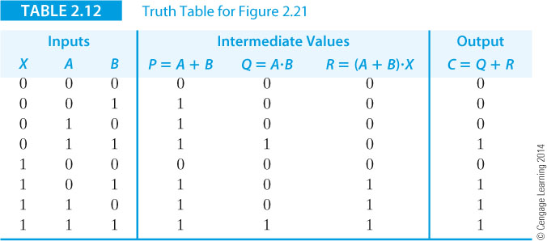
Computer Organization and Architecture: Themes and Variations, 1st Edition Clements

Slide 37
Computer Organization and Architecture: Themes and Variations, 1st Edition Clements

Slide 38
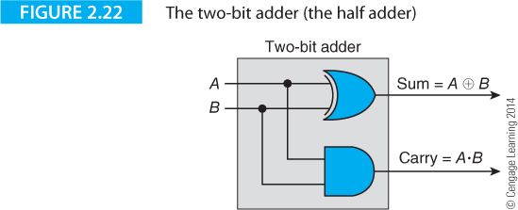
Computer Organization and Architecture: Themes and Variations, 1st Edition Clements

Slide 39
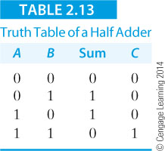
Computer Organization and Architecture: Themes and Variations, 1st Edition Clements

Slide 40
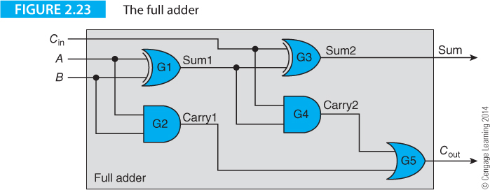
Computer Organization and Architecture: Themes and Variations, 1st Edition Clements

Slide 41
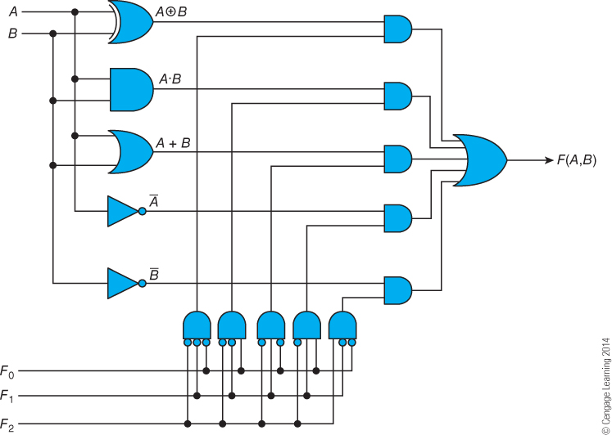
Computer Organization and Architecture: Themes and Variations, 1st Edition Clements

Slide 42
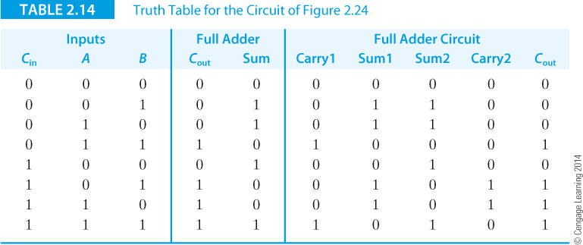
Computer Organization and Architecture: Themes and Variations, 1st Edition Clements

Slide 43
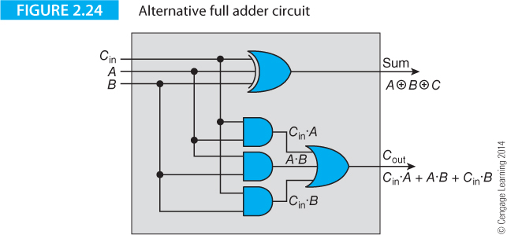
Computer Organization and Architecture: Themes and Variations, 1st Edition Clements

Slide 44
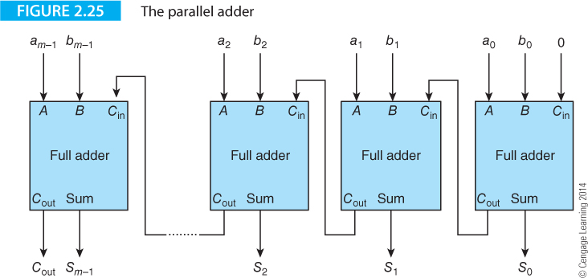
Computer Organization and Architecture: Themes and Variations, 1st Edition Clements

Slide 45
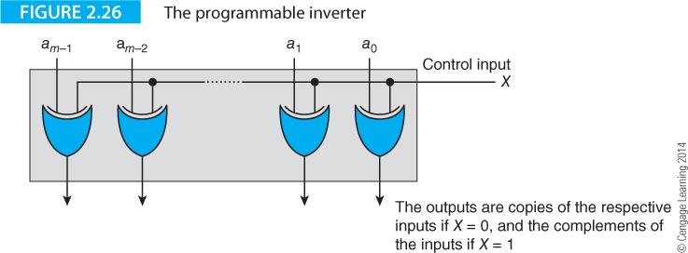
Computer Organization and Architecture: Themes and Variations, 1st Edition Clements

Slide 46
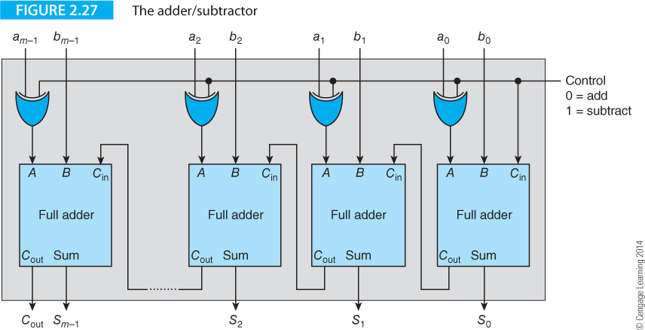
Computer Organization and Architecture: Themes and Variations, 1st Edition Clements

Slide 47
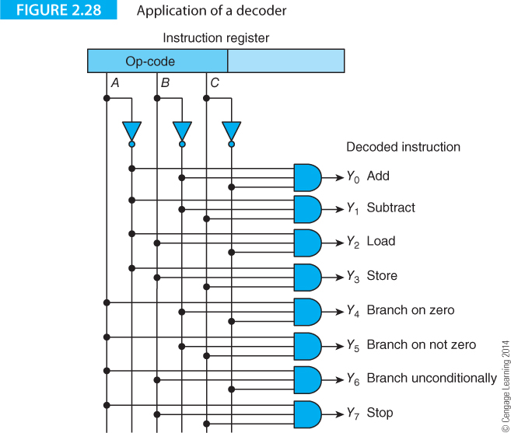
Computer Organization and Architecture: Themes and Variations, 1st Edition Clements

Slide 48
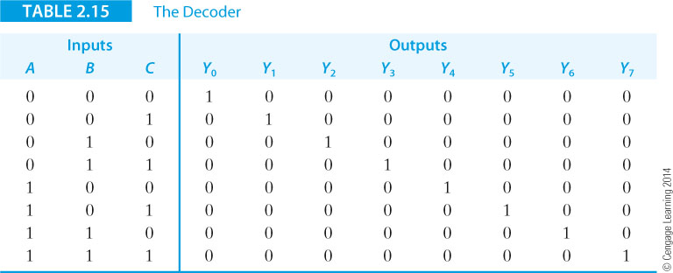
Computer Organization and Architecture: Themes and Variations, 1st Edition Clements

Slide 49
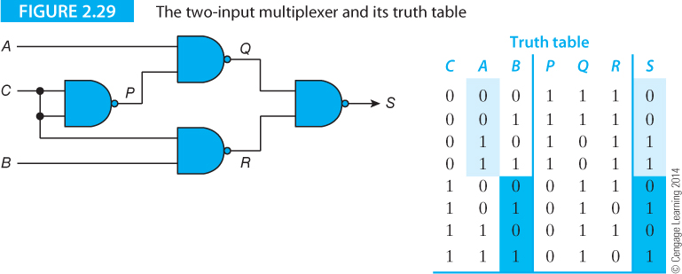
Computer Organization and Architecture: Themes and Variations, 1st Edition Clements

Slide 50
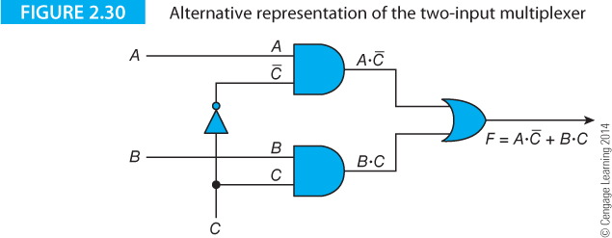
Computer Organization and Architecture: Themes and Variations, 1st Edition Clements

Slide 51
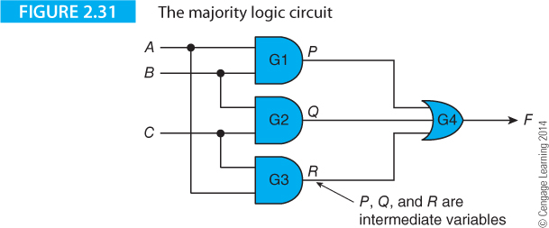
Computer Organization and Architecture: Themes and Variations, 1st Edition Clements

Slide 52
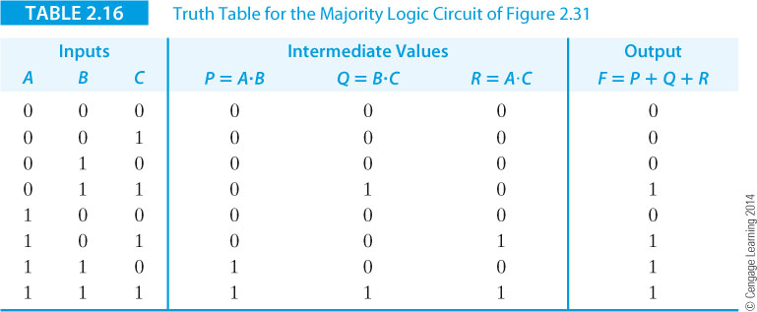
Computer Organization and Architecture: Themes and Variations, 1st Edition Clements

Slide 53
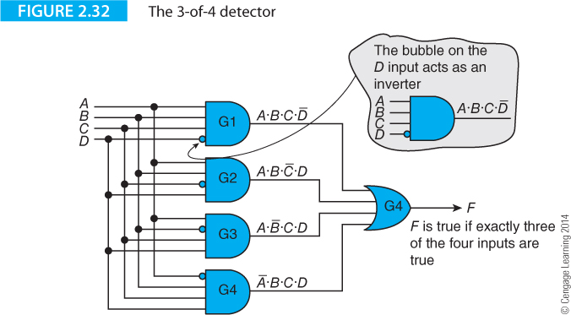
Computer Organization and Architecture: Themes and Variations, 1st Edition Clements

Slide 54
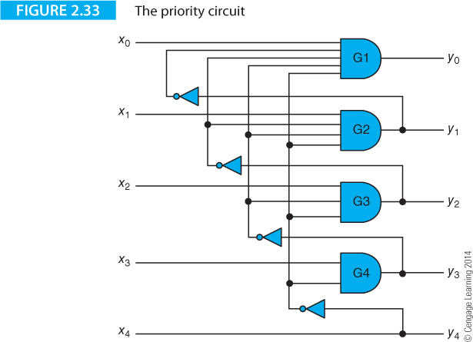
Computer Organization and Architecture: Themes and Variations, 1st Edition Clements

Slide 55
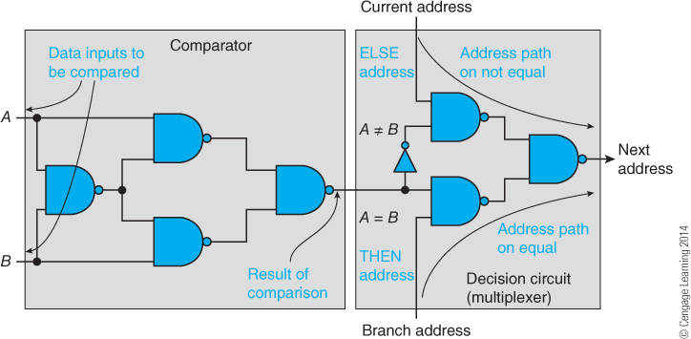
Computer Organization and Architecture: Themes and Variations, 1st Edition Clements

Slide 56
Computer Organization and Architecture: Themes and Variations, 1st Edition Clements

Slide 57
Computer Organization and Architecture: Themes and Variations, 1st Edition Clements

Slide 58
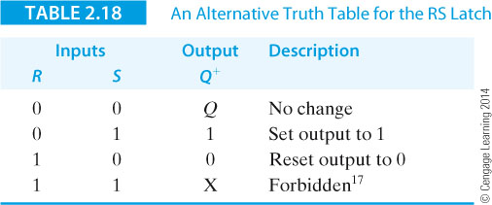
Computer Organization and Architecture: Themes and Variations, 1st Edition Clements

Slide 59
Computer Organization and Architecture: Themes and Variations, 1st Edition Clements

Slide 60
Computer Organization and Architecture: Themes and Variations, 1st Edition Clements

Slide 61
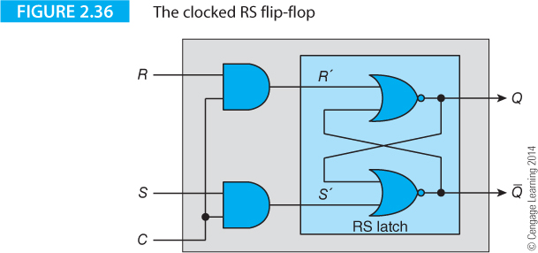
Computer Organization and Architecture: Themes and Variations, 1st Edition Clements

Slide 62
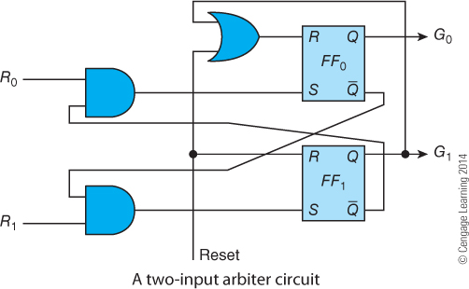
Computer Organization and Architecture: Themes and Variations, 1st Edition Clements

Slide 63
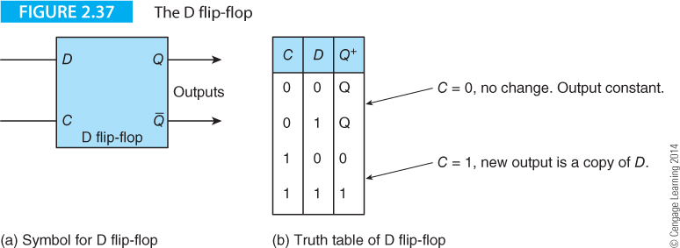
Computer Organization and Architecture: Themes and Variations, 1st Edition Clements

Slide 64
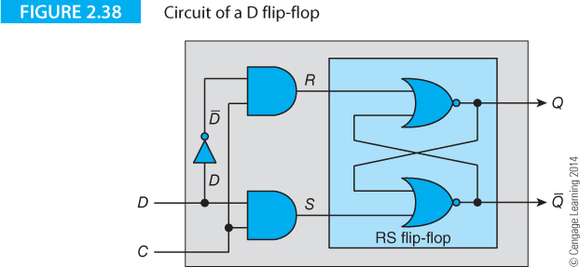
Computer Organization and Architecture: Themes and Variations, 1st Edition Clements

Slide 65
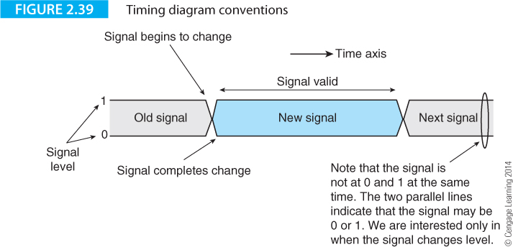
Computer Organization and Architecture: Themes and Variations, 1st Edition Clements

Slide 66
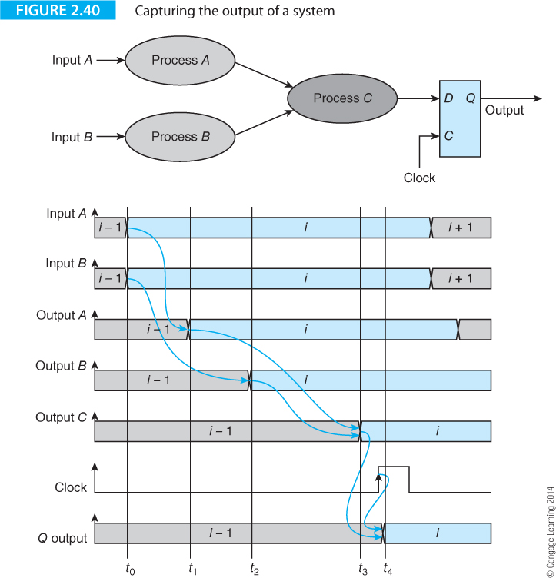
Computer Organization and Architecture: Themes and Variations, 1st Edition Clements

Slide 67
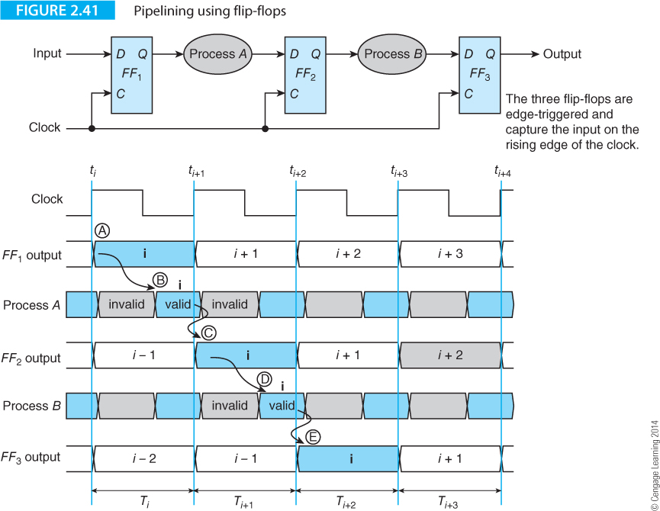
Computer Organization and Architecture: Themes and Variations, 1st Edition Clements

Slide 68
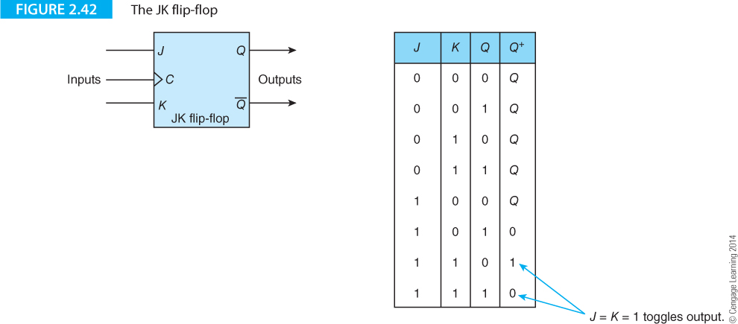
Computer Organization and Architecture: Themes and Variations, 1st Edition Clements

Slide 69
Computer Organization and Architecture: Themes and Variations, 1st Edition Clements

Slide 70
Computer Organization and Architecture: Themes and Variations, 1st Edition Clements

Slide 71
Computer Organization and Architecture: Themes and Variations, 1st Edition Clements

Slide 72
Computer Organization and Architecture: Themes and Variations, 1st Edition Clements

Slide 73
Computer Organization and Architecture: Themes and Variations, 1st Edition Clements

Slide 74
Computer Organization and Architecture: Themes and Variations, 1st Edition Clements

Slide 75
Computer Organization and Architecture: Themes and Variations, 1st Edition Clements

Slide 76
Computer Organization and Architecture: Themes and Variations, 1st Edition Clements

Slide 77
Computer Organization and Architecture: Themes and Variations, 1st Edition Clements

Slide 78
Computer Organization and Architecture: Themes and Variations, 1st Edition Clements

Slide 79
Computer Organization and Architecture: Themes and Variations, 1st Edition Clements

Slide 80
Computer Organization and Architecture: Themes and Variations, 1st Edition Clements

Slide 81
Computer Organization and Architecture: Themes and Variations, 1st Edition Clements

Slide 82
Computer Organization and Architecture: Themes and Variations, 1st Edition Clements

Slide 83
Computer Organization and Architecture: Themes and Variations, 1st Edition Clements

Slide 84
Computer Organization and Architecture: Themes and Variations, 1st Edition Clements

Slide 85
Computer Organization and Architecture: Themes and Variations, 1st Edition Clements

Slide 86
Computer Organization and Architecture: Themes and Variations, 1st Edition Clements

Slide 87
Computer Organization and Architecture: Themes and Variations, 1st Edition Clements

Slide 88
Computer Organization and Architecture: Themes and Variations, 1st Edition Clements

Slide 89
Computer Organization and Architecture: Themes and Variations, 1st Edition Clements

Slide 90
Computer Organization and Architecture: Themes and Variations, 1st Edition Clements

Slide 91
Computer Organization and Architecture: Themes and Variations, 1st Edition Clements

Slide 92
Computer Organization and Architecture: Themes and Variations, 1st Edition Clements

Slide 93
Computer Organization and Architecture: Themes and Variations, 1st Edition Clements

Slide 94
Computer Organization and Architecture: Themes and Variations, 1st Edition Clements

Slide 95
Computer Organization and Architecture: Themes and Variations, 1st Edition Clements

Slide 96
Computer Organization and Architecture: Themes and Variations, 1st Edition Clements

Slide 97
Computer Organization and Architecture: Themes and Variations, 1st Edition Clements

Slide 98
Computer Organization and Architecture: Themes and Variations, 1st Edition Clements

Slide 99
Computer Organization and Architecture: Themes and Variations, 1st Edition Clements

Slide 100
Computer Organization and Architecture: Themes and Variations, 1st Edition Clements

