Slide 1
Chapter 6
Computer Organization and Architecture: Themes and Variations, 1st Edition Clements
Performance–Meaning and Metrics

Slide 2
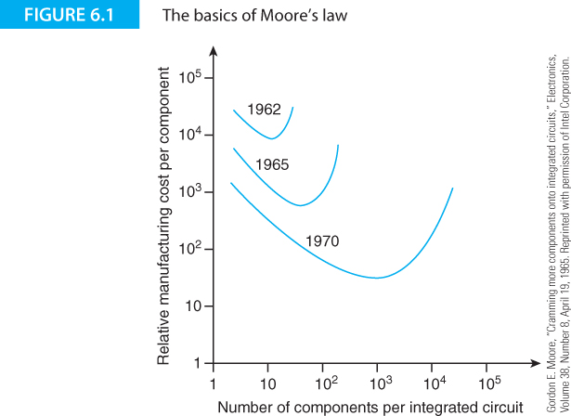
Computer Organization and Architecture: Themes and Variations, 1st Edition Clements

Slide 3
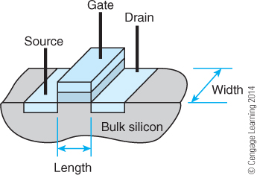
Computer Organization and Architecture: Themes and Variations, 1st Edition Clements

Slide 4
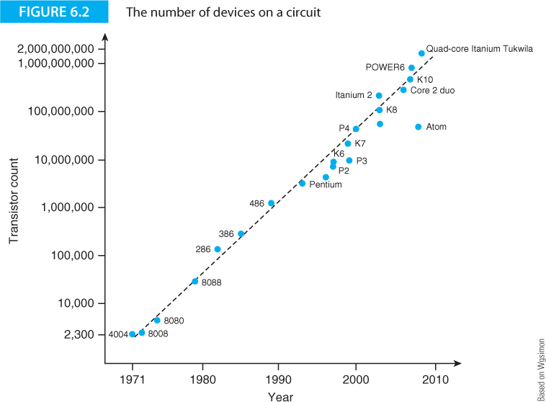
Computer Organization and Architecture: Themes and Variations, 1st Edition Clements

Slide 5
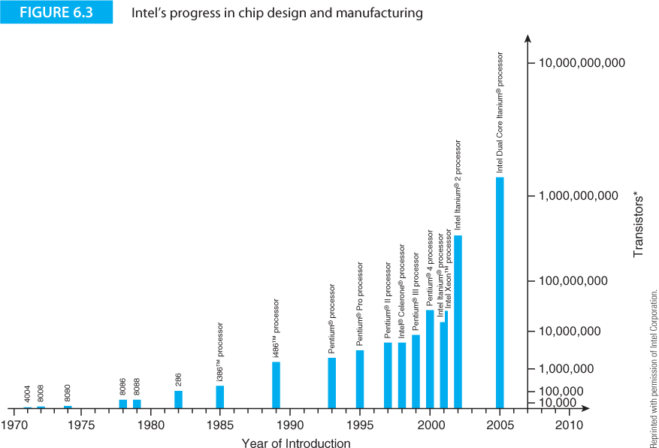
Computer Organization and Architecture: Themes and Variations, 1st Edition Clements

Slide 6
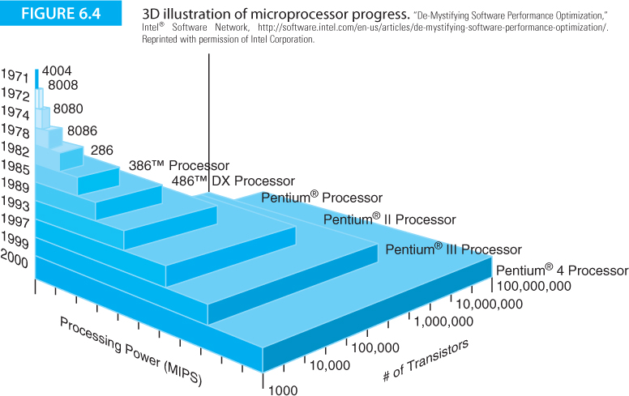
Computer Organization and Architecture: Themes and Variations, 1st Edition Clements

Slide 7
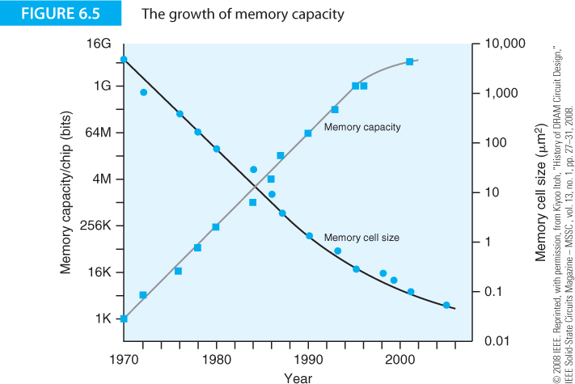
Computer Organization and Architecture: Themes and Variations, 1st Edition Clements

Slide 8
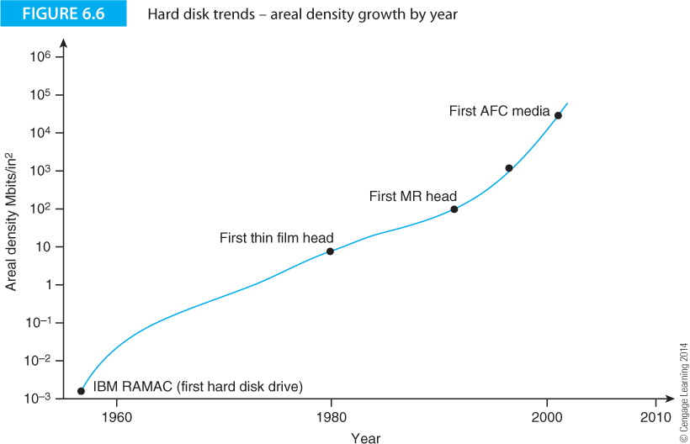
Computer Organization and Architecture: Themes and Variations, 1st Edition Clements

Slide 9
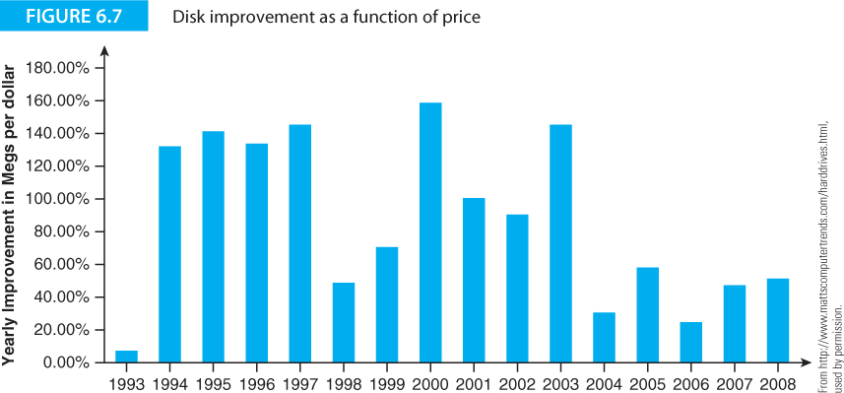
Computer Organization and Architecture: Themes and Variations, 1st Edition Clements

Slide 10
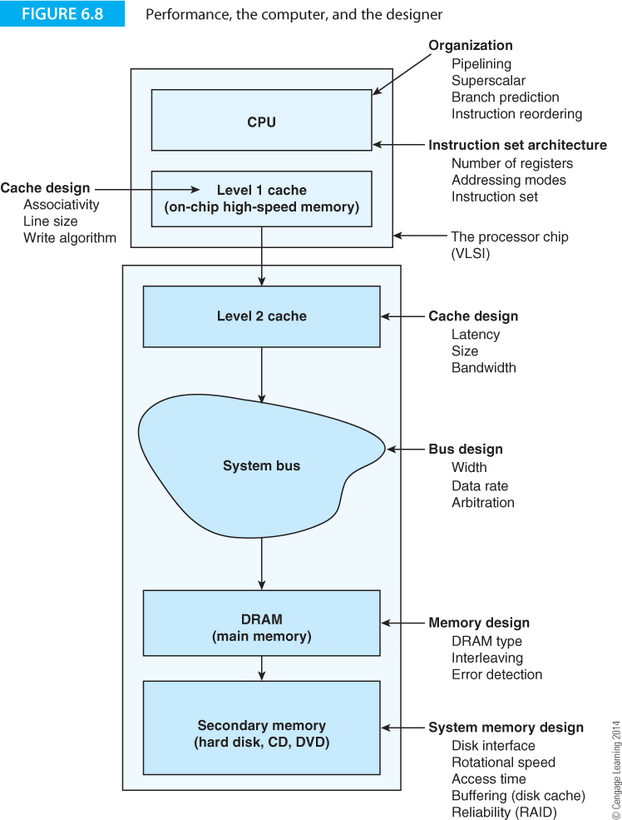
Computer Organization and Architecture: Themes and Variations, 1st Edition Clements

Slide 11
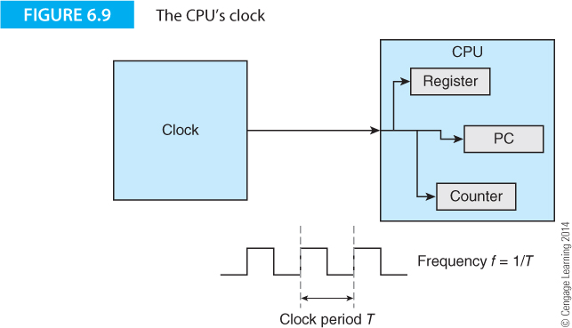
Computer Organization and Architecture: Themes and Variations, 1st Edition Clements

Slide 12
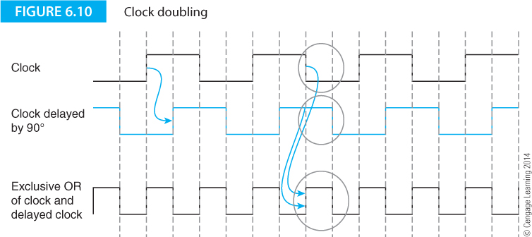
Computer Organization and Architecture: Themes and Variations, 1st Edition Clements

Slide 13
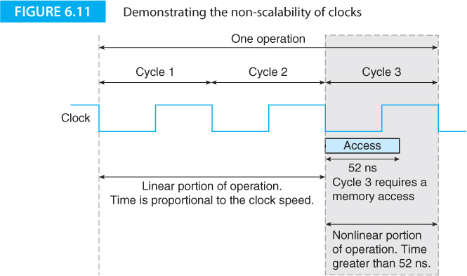
Computer Organization and Architecture: Themes and Variations, 1st Edition Clements

Slide 14
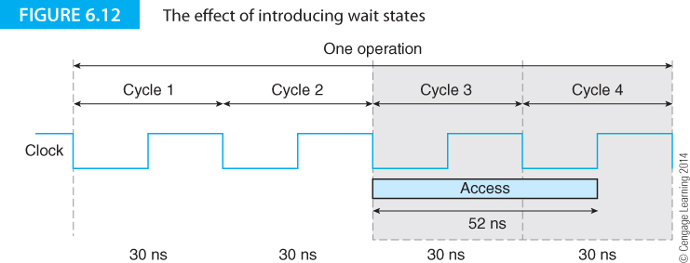
Computer Organization and Architecture: Themes and Variations, 1st Edition Clements

Slide 15
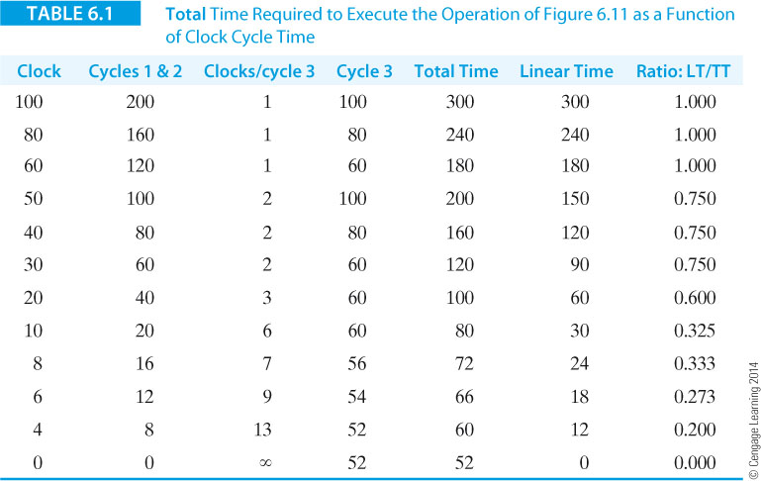
Computer Organization and Architecture: Themes and Variations, 1st Edition Clements

Slide 16
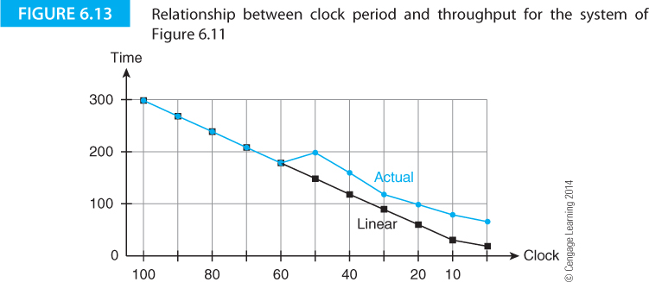
Computer Organization and Architecture: Themes and Variations, 1st Edition Clements

Slide 17
Computer Organization and Architecture: Themes and Variations, 1st Edition Clements

Slide 18
Computer Organization and Architecture: Themes and Variations, 1st Edition Clements

Slide 19
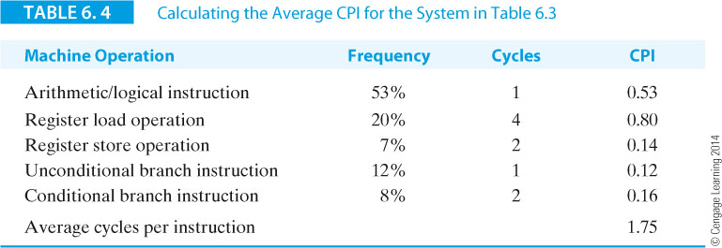
Computer Organization and Architecture: Themes and Variations, 1st Edition Clements

Slide 20
Computer Organization and Architecture: Themes and Variations, 1st Edition Clements

Slide 21
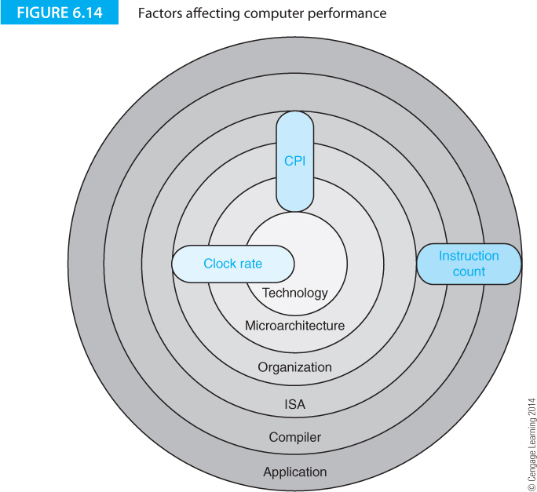
Computer Organization and Architecture: Themes and Variations, 1st Edition Clements

Slide 22
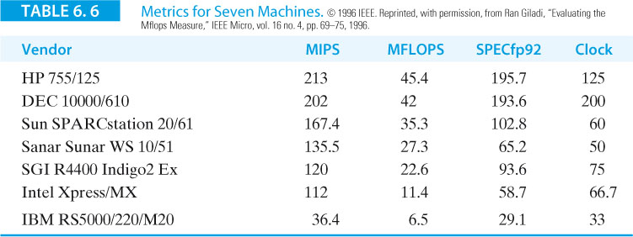
Computer Organization and Architecture: Themes and Variations, 1st Edition Clements

Slide 23
Computer Organization and Architecture: Themes and Variations, 1st Edition Clements

Slide 24
Computer Organization and Architecture: Themes and Variations, 1st Edition Clements

Slide 25
Computer Organization and Architecture: Themes and Variations, 1st Edition Clements

Slide 26
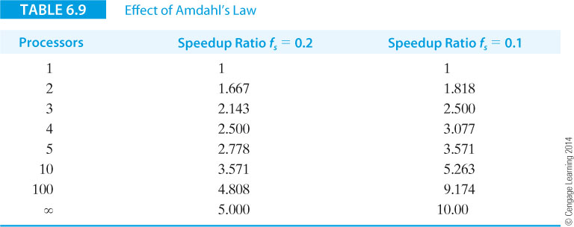
Computer Organization and Architecture: Themes and Variations, 1st Edition Clements

Slide 27
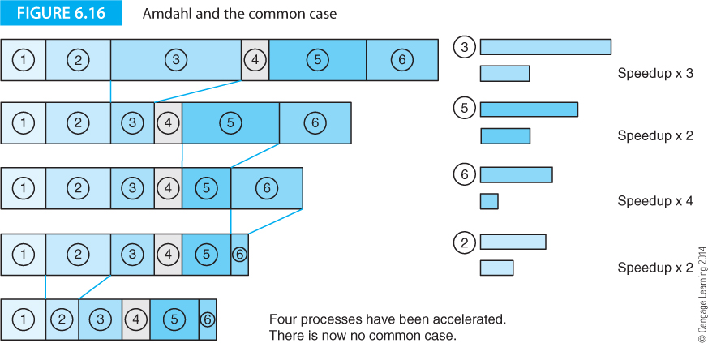
Computer Organization and Architecture: Themes and Variations, 1st Edition Clements

Slide 28
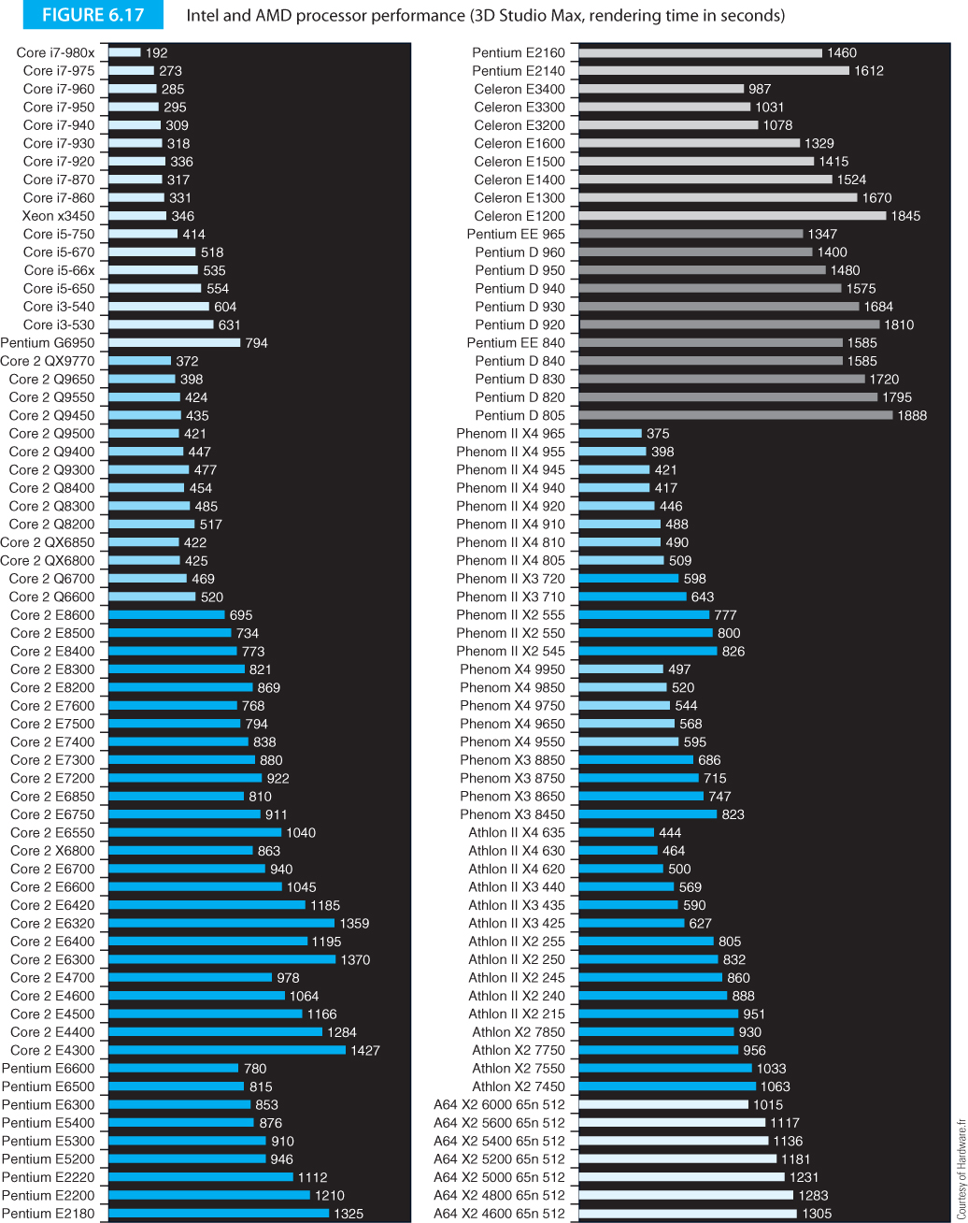
Computer Organization and Architecture: Themes and Variations, 1st Edition Clements

Slide 29
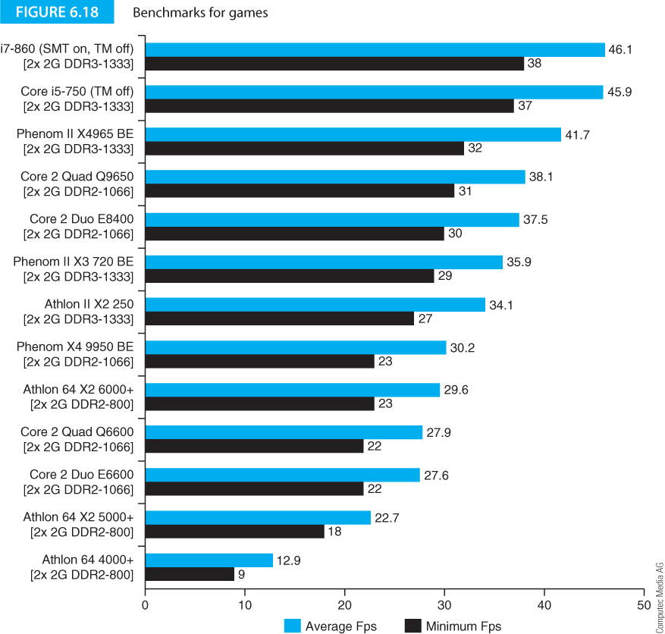
Computer Organization and Architecture: Themes and Variations, 1st Edition Clements

Slide 30
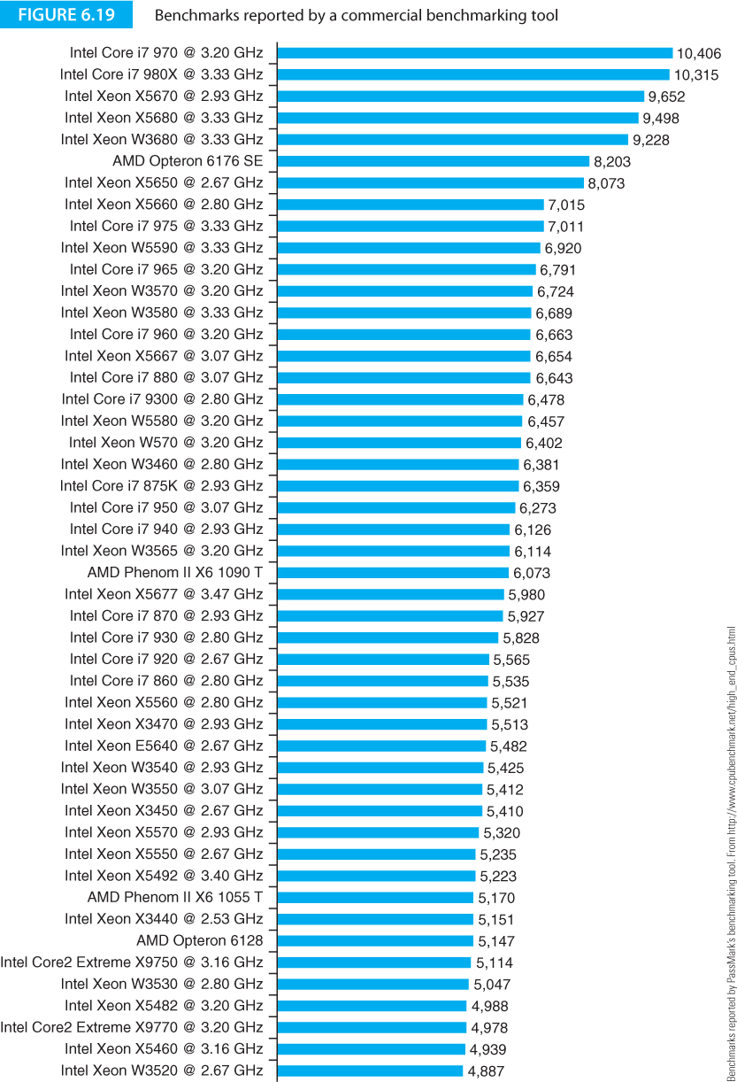
Computer Organization and Architecture: Themes and Variations, 1st Edition Clements

Slide 31
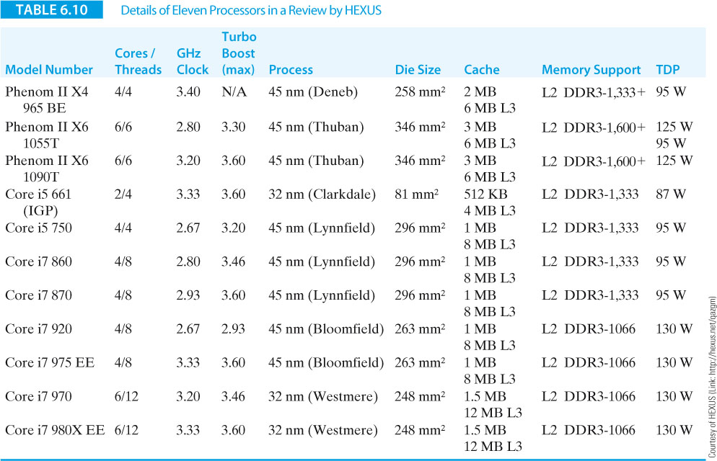
Computer Organization and Architecture: Themes and Variations, 1st Edition Clements

Slide 32
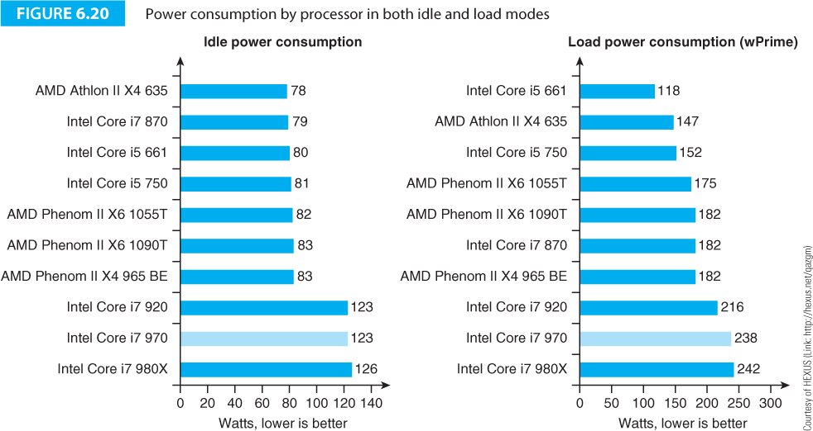
Computer Organization and Architecture: Themes and Variations, 1st Edition Clements

Slide 33
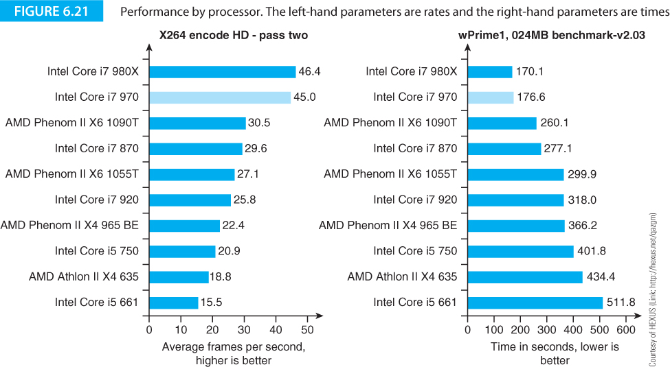
Computer Organization and Architecture: Themes and Variations, 1st Edition Clements

Slide 34
Computer Organization and Architecture: Themes and Variations, 1st Edition Clements

Slide 35
Computer Organization and Architecture: Themes and Variations, 1st Edition Clements

Slide 36
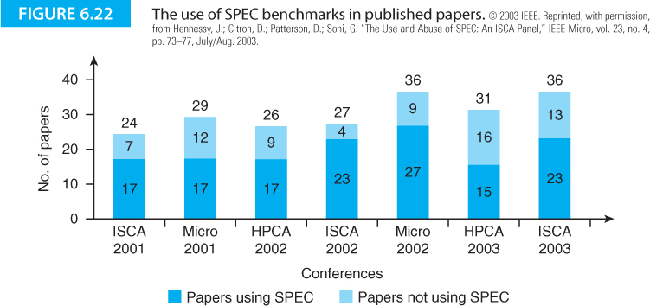
Computer Organization and Architecture: Themes and Variations, 1st Edition Clements

Slide 37
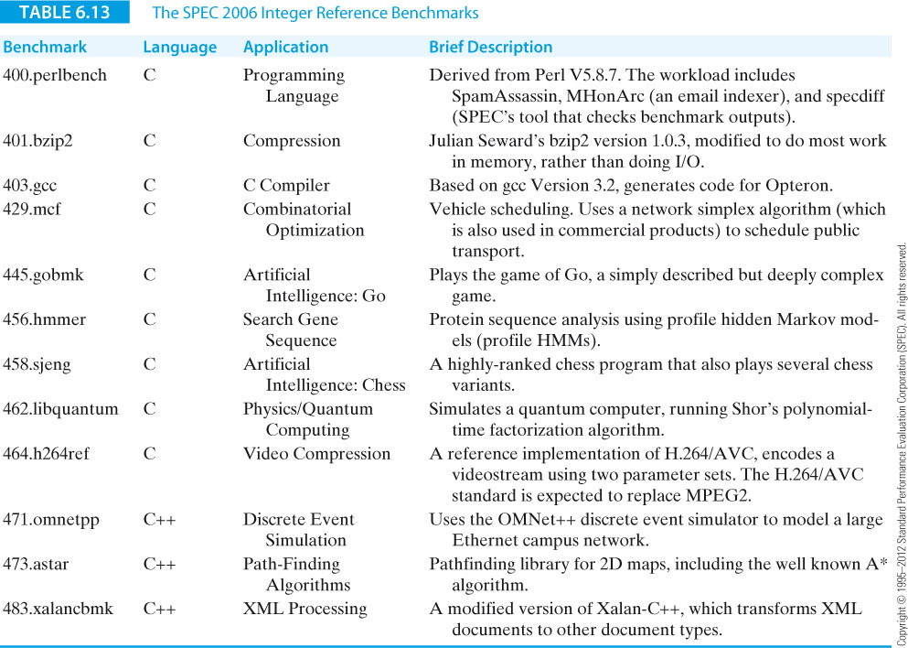
Computer Organization and Architecture: Themes and Variations, 1st Edition Clements

Slide 38
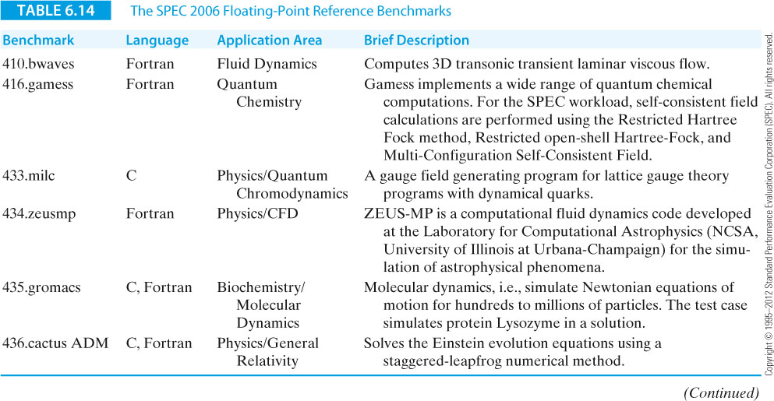
Computer Organization and Architecture: Themes and Variations, 1st Edition Clements

Slide 39
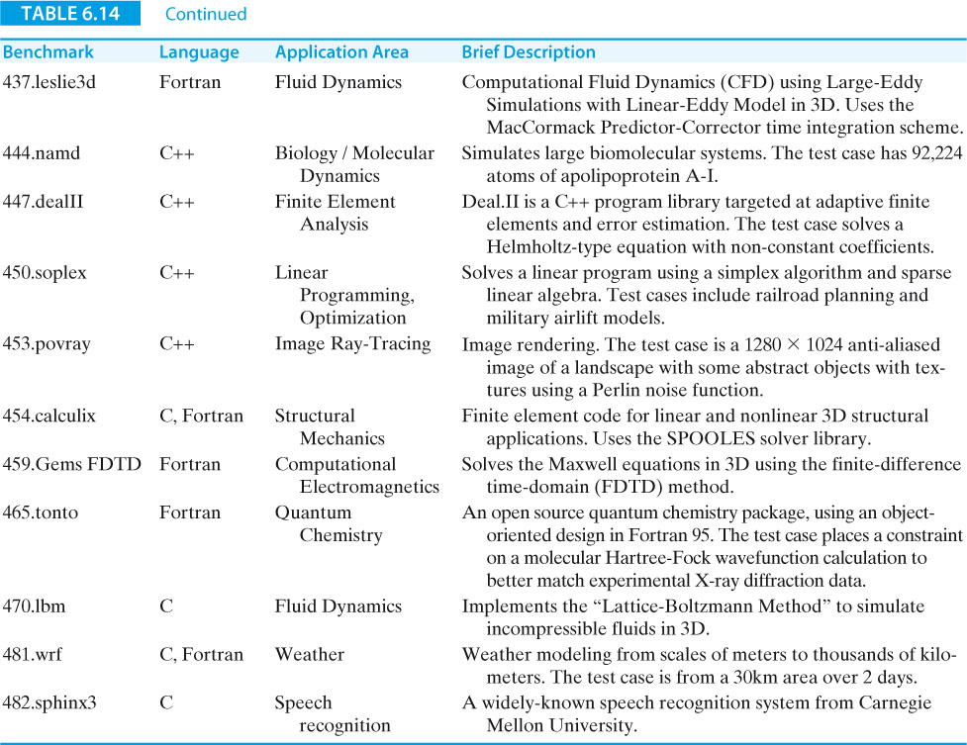
Computer Organization and Architecture: Themes and Variations, 1st Edition Clements

Slide 40
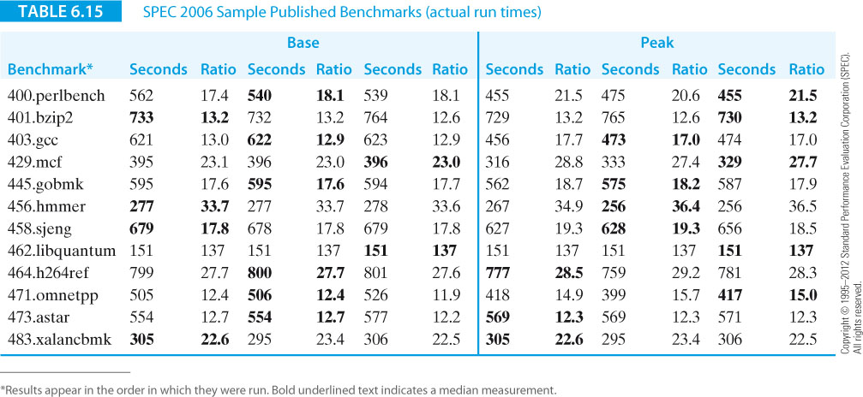
Computer Organization and Architecture: Themes and Variations, 1st Edition Clements

Slide 41
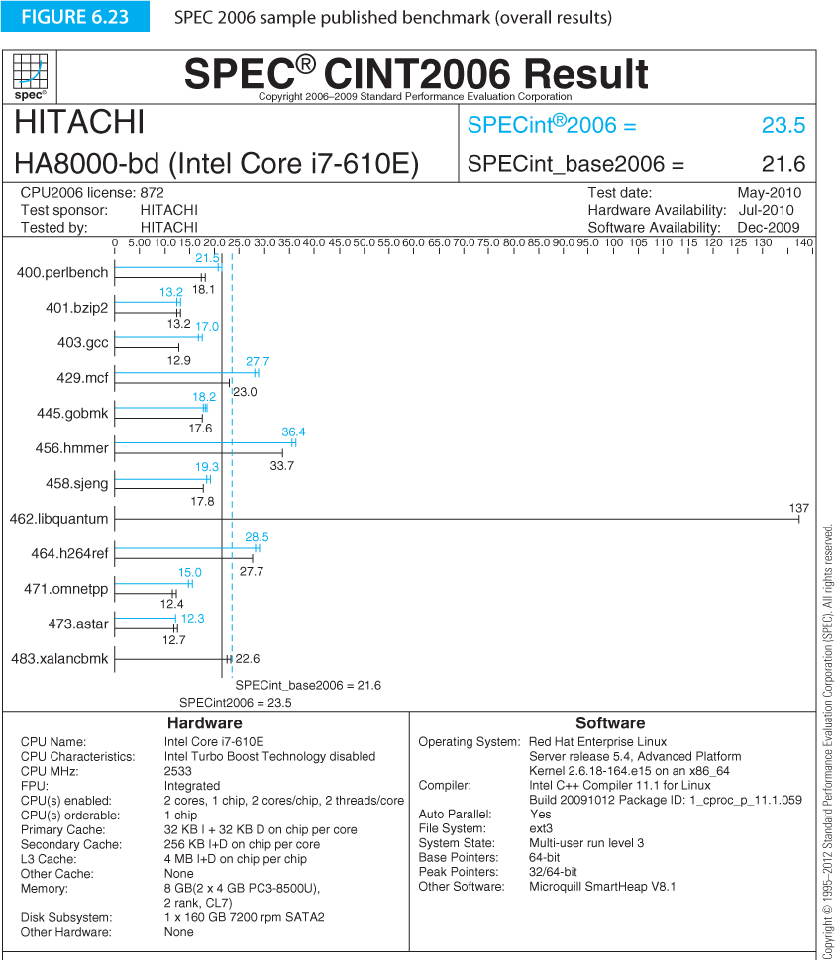
Computer Organization and Architecture: Themes and Variations, 1st Edition Clements

Slide 42
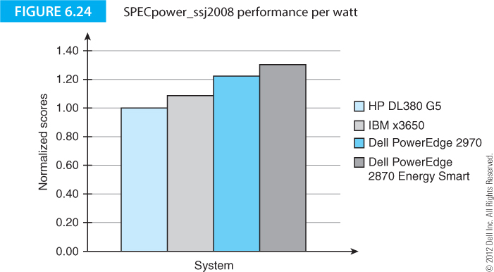
Computer Organization and Architecture: Themes and Variations, 1st Edition Clements

Slide 43
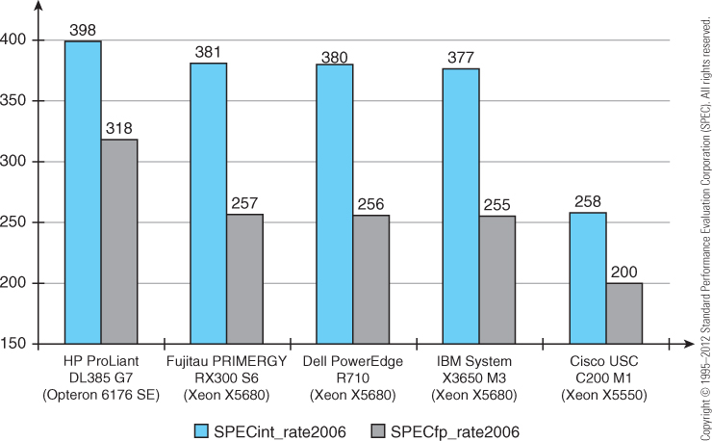
Computer Organization and Architecture: Themes and Variations, 1st Edition Clements

Slide 44
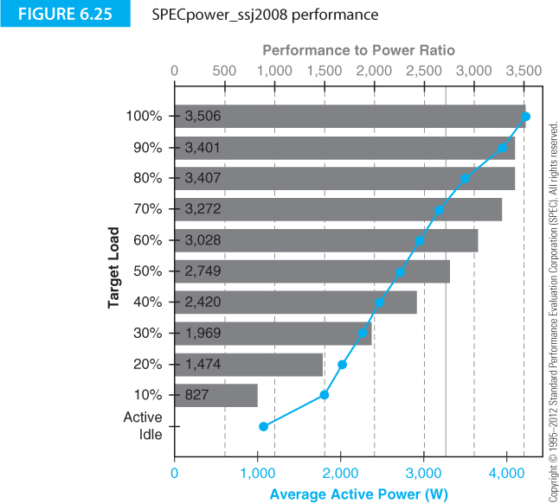
Computer Organization and Architecture: Themes and Variations, 1st Edition Clements

Slide 45
Computer Organization and Architecture: Themes and Variations, 1st Edition Clements

Slide 46
Computer Organization and Architecture: Themes and Variations, 1st Edition Clements

Slide 47
Computer Organization and Architecture: Themes and Variations, 1st Edition Clements

Slide 48
Computer Organization and Architecture: Themes and Variations, 1st Edition Clements

Slide 49
Computer Organization and Architecture: Themes and Variations, 1st Edition Clements

Slide 50
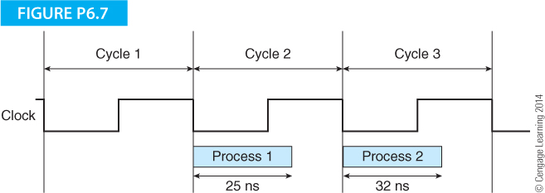
Computer Organization and Architecture: Themes and Variations, 1st Edition Clements

Slide 51
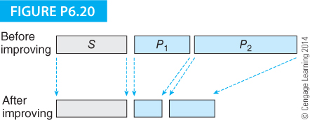
Computer Organization and Architecture: Themes and Variations, 1st Edition Clements

