Slide 1
The Big Event

Slide 2
Lingering Questions about Code.org website?

Slide 3
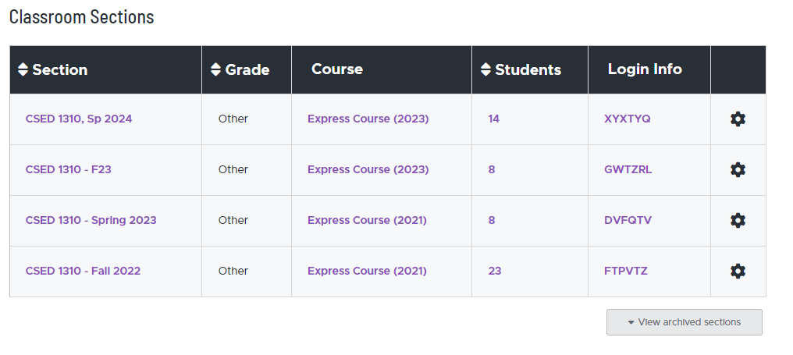

Slide 4
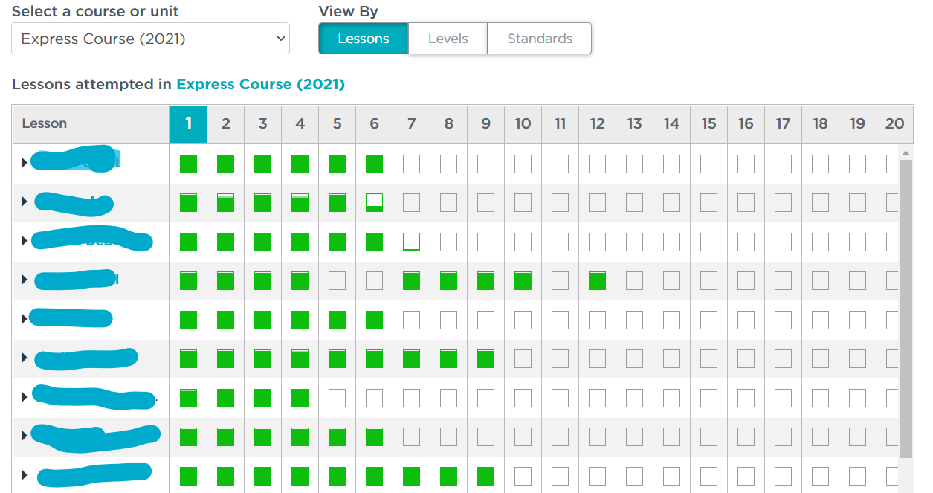

Slide 5
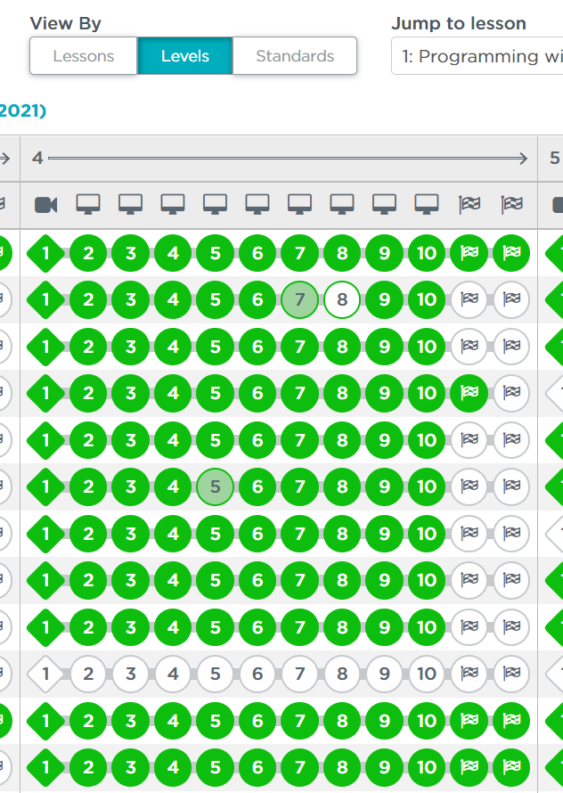

Slide 6
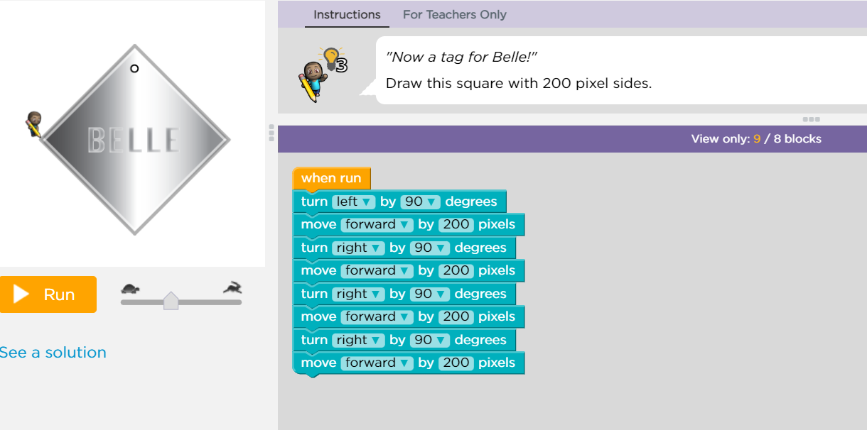

Slide 7
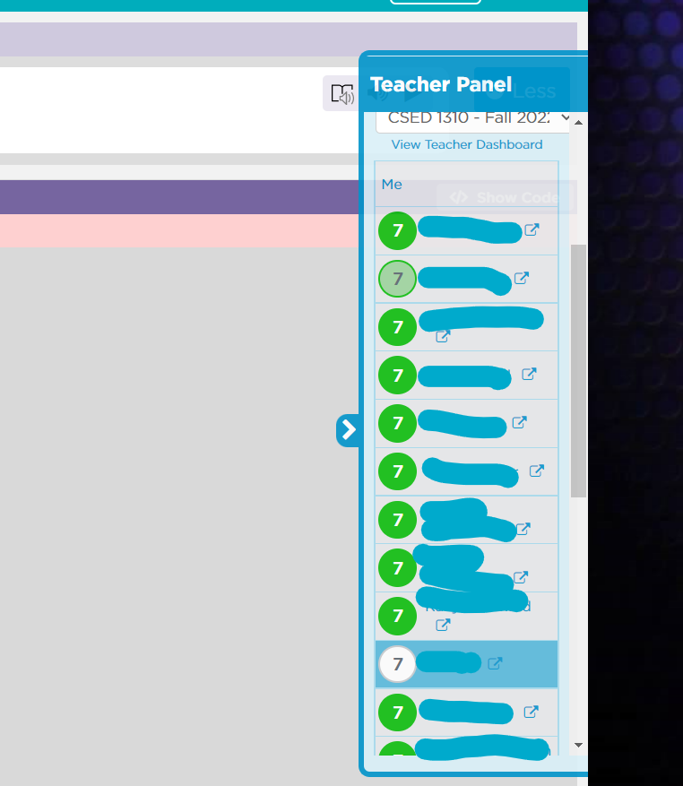

Slide 8
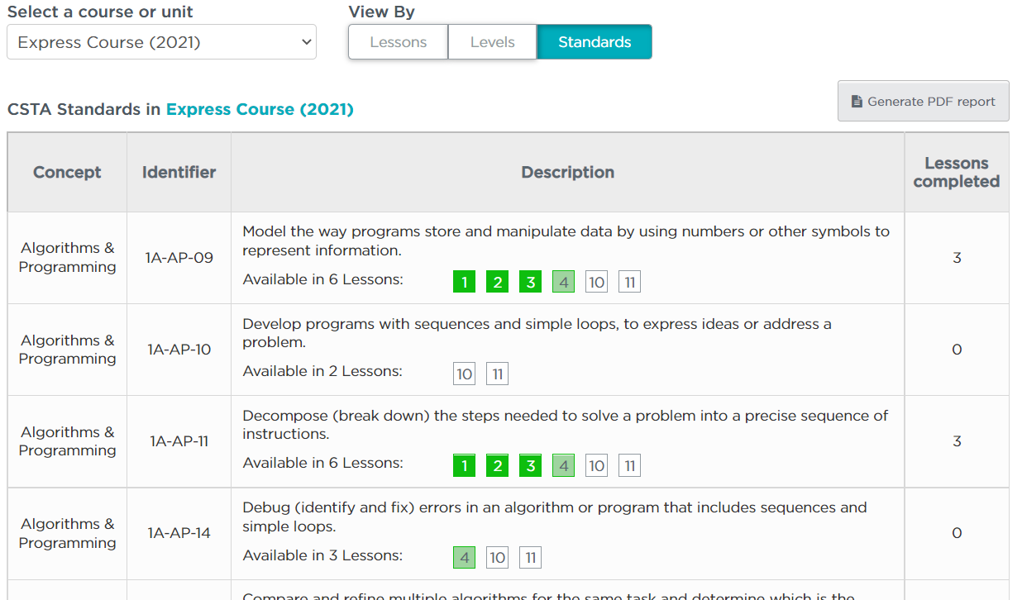

Slide 9
What did we do in our last classroom lesson?
What vocabulary words did we introduce?
What was your favorite part of the last lesson?
Any questions before we move on?

Slide 10
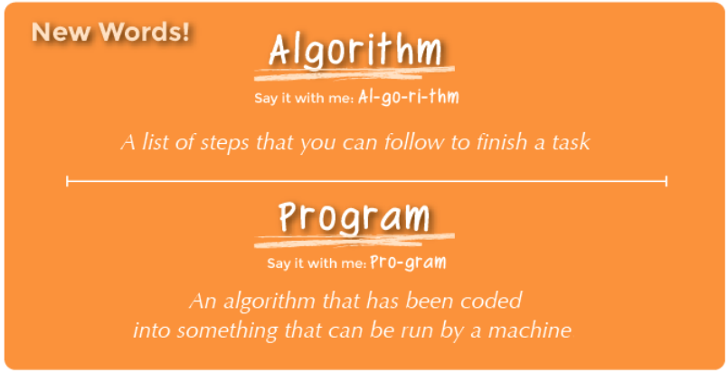
REVIEW

Slide 11
What did we do you do in your online activities?
  Lesson 3
  Lesson 4

Slide 12
What did we do you do in your online activities?
  Lesson 3
    Helped Laurel get to the treasure
  Lesson 4
    Creating artwork

Slide 13
The Big Event
Today we are going to introduce one new vocabulary word:
  Event
Listen for it in the following video.

Slide 14


Slide 15
The Big Event
Did you hear our new vocabulary word:
  Event
What did this word mean?

Slide 17
The Big Event
I asked a question on the previous slide.
How did I know you wanted me to call on you?

Slide 18
Can you give me examples of other things that are events?

Slide 19
Can you give me examples of other things that are events?
What about an alarm clock going off? What does that make happen?
What about pressing "Start" on the microwave? What does that do?
What about pressing the power button on your tv remote?

Slide 20
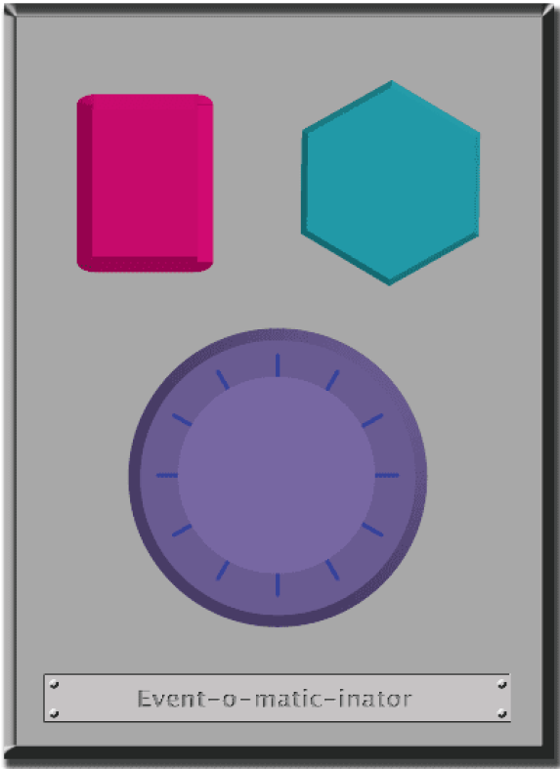

Slide 21
Let's look at the Code.org lesson plan

Slide 22
Debrief
What do you like about the lesson itself?
Where might your students struggle with this?
What might you try differently?
What additional activities could you do?

