Slide 1
Introduction to Programming Environments for Elementary Education
www.cs.uni.edu/~schafer/1310/

Slide 2
Getting to Know You form
Thanks for everyone who took the time to complete this form.
http://bit.ly/Schafer_gtky
It was fun to get to know you.

Slide 3
What would have been on my form?
Name: Dr. Ben Schafer
Hometown: Ames originally
Major: As an undergrad I was a double major of Math and Physics teaching
I taught 7th and 8th grade math and science for four years
But I took several computer science classes and worked in the summers writing educational, multi-media software.
Eventually went back to learn more

Slide 4
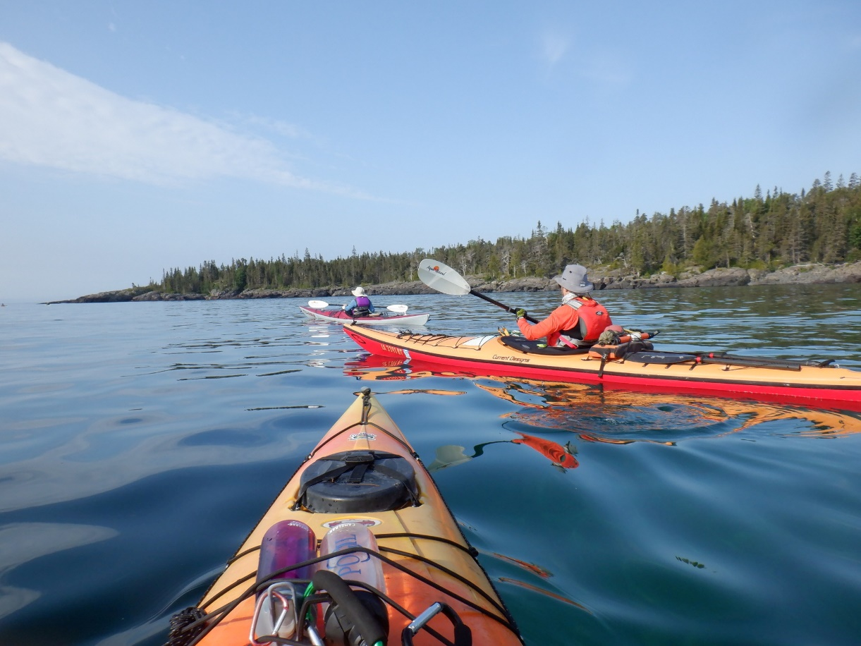
What would be on my form?
Three fun facts about you
I love to snowshoe, hike, or kayak depending on the season

Slide 5
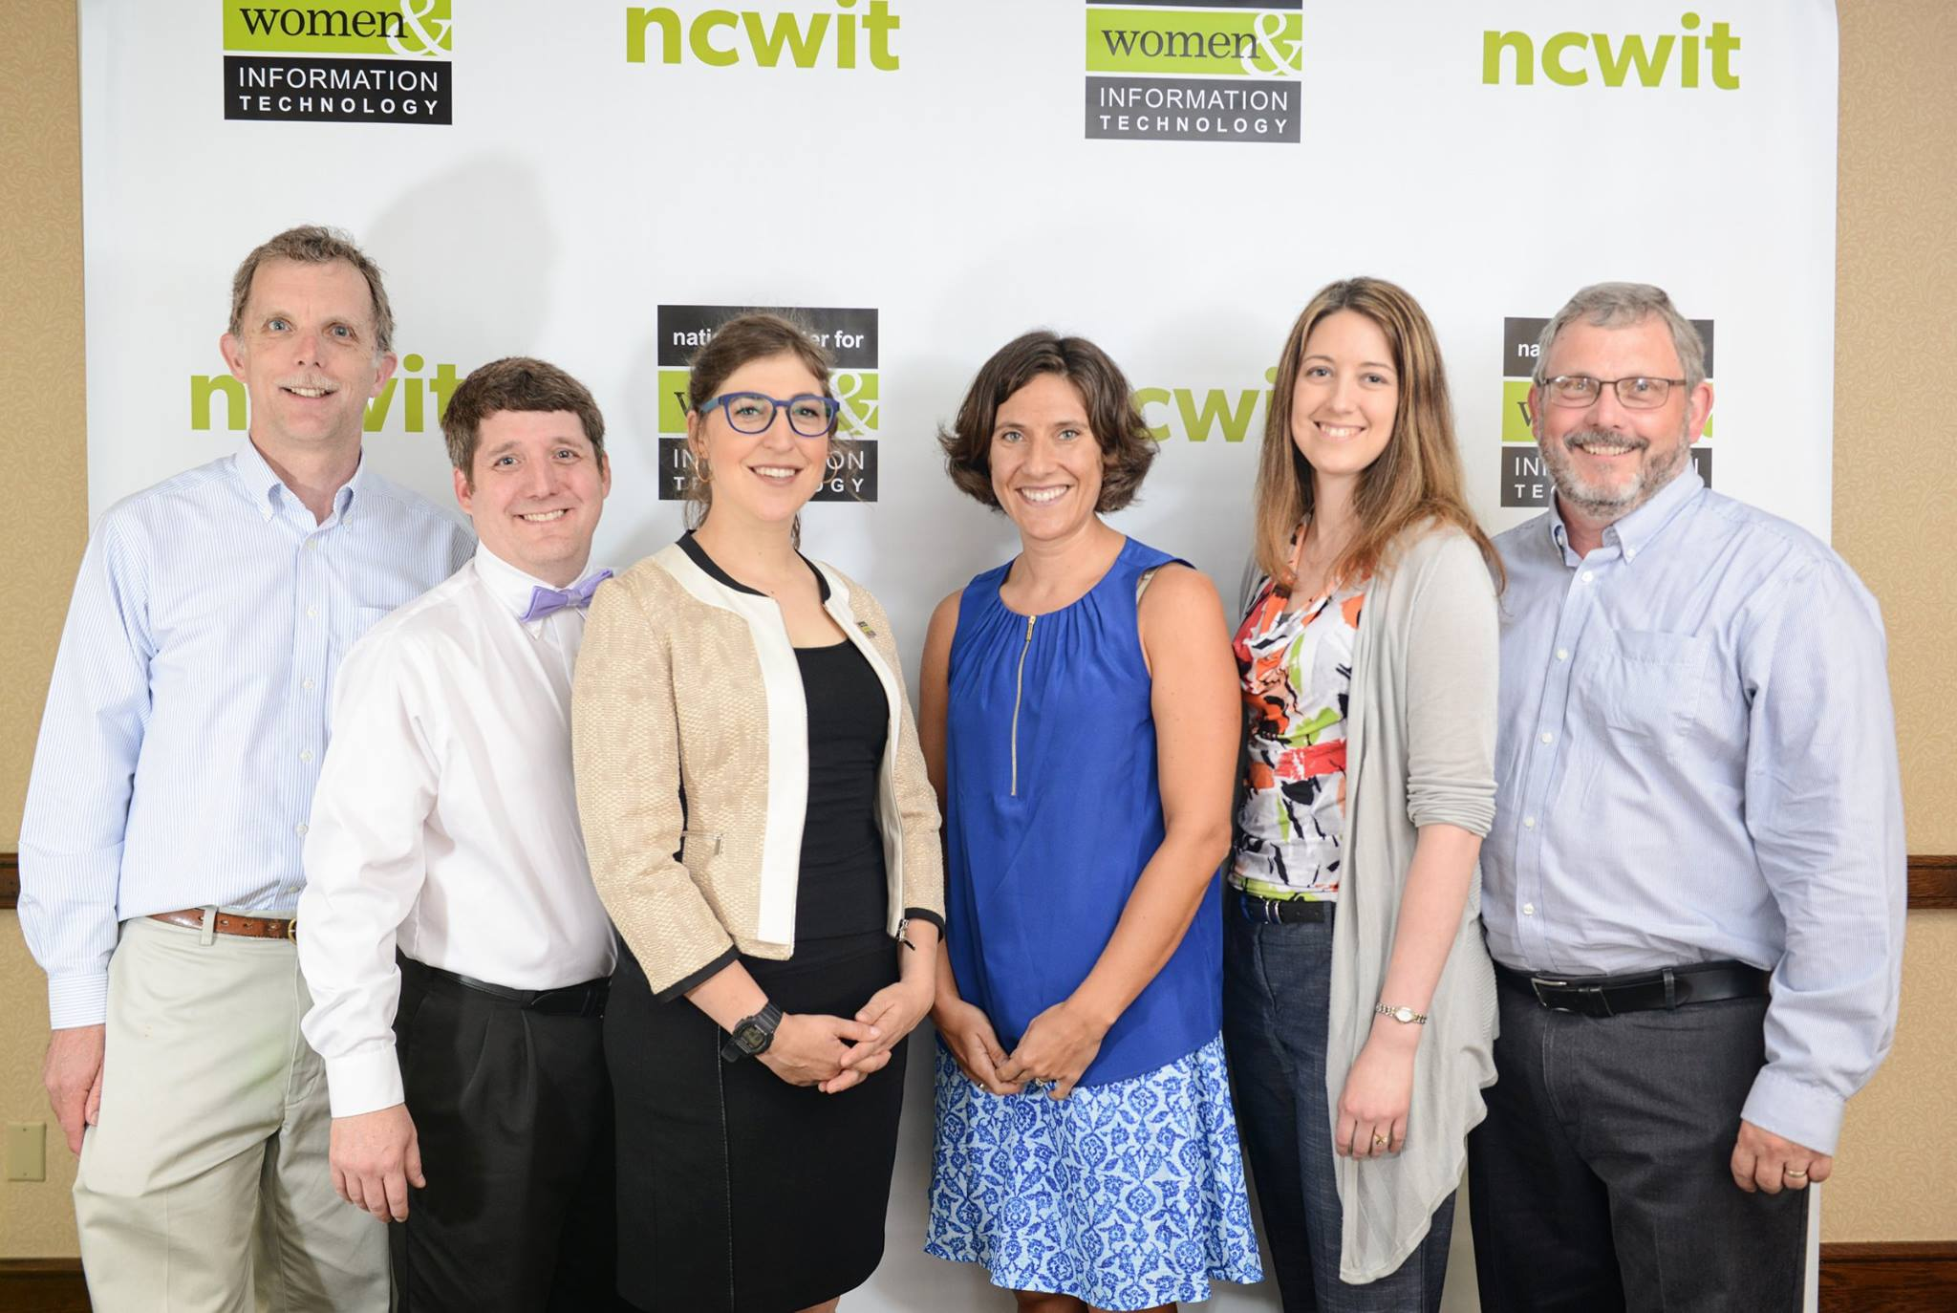
What would be on my form?
Three fun facts about you
I received an award presented by Mayim Bialik

Slide 6
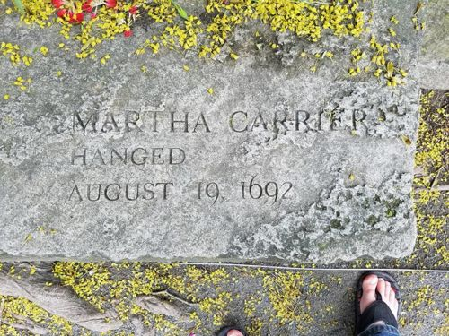
What would be on my form?
Three fun facts about you
My great(x8) grandmother was hung as a witch during the Salem Witch Trials

Slide 7
Why this course?
Some of you said:
To learn more about Computer Science
Most of you said:
Because it's required for my major

Slide 8
How many years of each of the following do you need to graduate high school in Iowa?
English
Math
Science
Social Studies

Slide 9
How many years of each of the following do you need to graduate high school in Iowa?
English 4 years
Math 3 years
Science 3 years
Social Studies 3 years

Slide 11
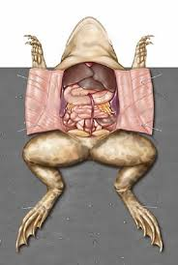
A Basic Circuit
a²+ b²⁼ c²
c
a
Neutral Wire
Hot Wire
Voltage Source
b

Slide 12
START
Initialization
Projection
Vertex Optimization
Add new vertex
Convergence?
N
Y
k>c(n, Δ)?
N
Y
END

Slide 13
Where does Iowa fit into all of this?
High School
EVERY school must offer a "high quality" CS course
Middle School
EVERY school must require a course on CS
Elementary School
EVERY school must make CS a significant component of education for at least one grade band 1-6 grade

Slide 14
What does a career look like for a student graduating in 2036?

Slide 15
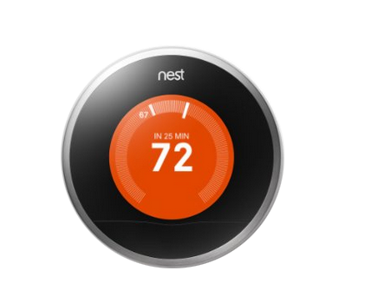
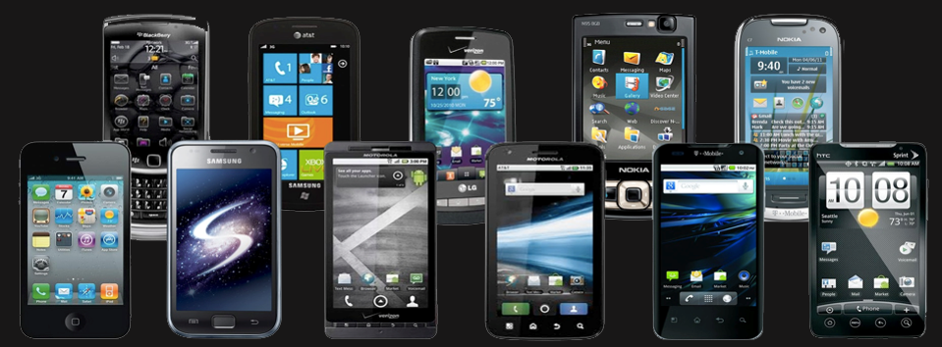
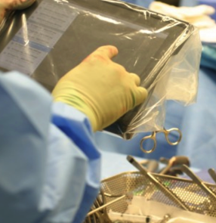
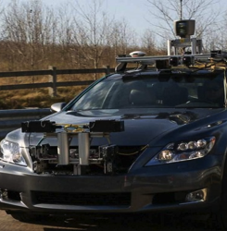
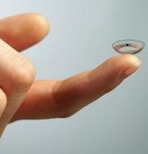
Technology affects EVERY field

Slide 16
Why CS Matters
I believe that computing is so fundamental to understanding and participating in society that it is valuable for every student to learn as part of a modern education.
Computer science is not only a "science" but a liberal art
a subject that provides students with a critical lens for interpreting the world around them.
Computer science prepares all students to be active and informed contributors to our increasingly technological society whether they pursue careers in technology or not.
Computer science can be life-changing, not just skill training.

Slide 17
Course Details
We will use multiple websites this semester
My personal website
www.cs.uni.edu/~schafer/1310/
Blackboard/eLearning
AEAOnline
Code.org
Scratch

Slide 18
Course Details
The full syllabus is on my class website
www.cs.uni.edu/~schafer/1310/
I spent a lot of time preparing this syllabus.
Please take 15 minutes to read the syllabus prior to the next class.
We will start class by answering questions you have.

Slide 19
Course Details
How I will handle "student hours"
MWF 11:00-11:50 – Drop in or reservation
MWF 2:00-3:00 – Drop in or reservation
MW 3:00-4:00 – Reservation Only
To meet with me:
https://bit.ly/SchaferScheduler
If you need something else, PLEASE email me

Slide 20
How grades will be earned
Grades in this class are very earned VERY differently than what you are likely used to
I don't do the whole 90/80/70/60 thing
Why?
That process seems to be arbitrary
What does a 17/20 even mean?
Even with a good rubric, what does everything mean
That process seems to focus on points rather than learning
You got a 50/100 on this exam.
You can't possibly earn an A any more.
Screw you!

Slide 21
How grades will be earned
I base my grading off of
Standards based
Equitable grading (gradingforequity.com)
Why?
It focusses on whether you LEARNED the material
That's LARGELY a yes/no decision
It allows you to fix something if you didn't learn it the first time
Almost ALL grades can be replaced if you can show me you worked to learn what you missed the first time through

Slide 22
How grades will be earned
This class focusses on 14 standards
Eight computer science/programming related
Six teaching related
For each standard you will earn a score from 1-4

Slide 23
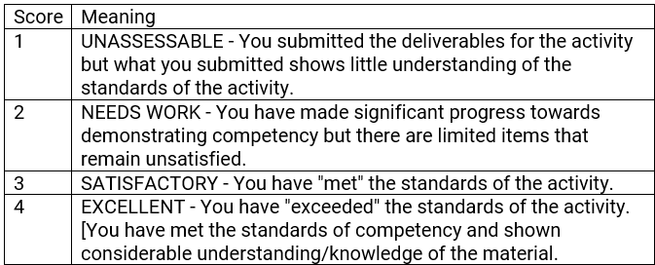
How grades will be earned

Slide 24
How grades will be earned
Competency Activity (CA) Grades
You can think of these like "homework" assignments.
Most will be one activity for one grade.
However, some (specifically CA1 and CA8) will consist of several pieces evaluated as a whole.
Most CAs will be given an evaluation based on the rubric published with the activity. If you do not earn the grade you would like to earn on the activity, you will have an opportunity to revise and resubmit for a (hopefully) improved grade.

Slide 25
How grades will be earned
Competency Demos (CD)
You can think of these like exams.
Each will be administered using Blackboard DURING class.

Slide 26
How grades will be earned
Competency Demos
Each question will receive a "grade"
Based on the question grades I will assign overall CD scores tied to the two learning strands
Note, the overall score is NOT necessarily the average of the question grades
3 + 3 + 3 + 3 = 12 will likely be an overall grade of 3
4 + 4 + 2 + 2 = 12 will likely be an overall grade of 2

Slide 27
How grades will be earned
Competency Demos (CD)
You can think of these like exams.
Each will be administered using Blackboard DURING class.
If you do not like the grade you earned on the original CDs, you will be provided an opportunity to ask questions, re-study the material, and attempt a second CD to improve your grade. Details on this will be provided when it becomes an option.

Slide 28
How grades will be earned
The Final Project/CD is your chance to put all of the pieces together and show me what you have learned.
This is the only activity all semester for which you will not be given an opportunity to improve your grade.
This is also where you might earn a plus or minus on your grade.

Slide 29
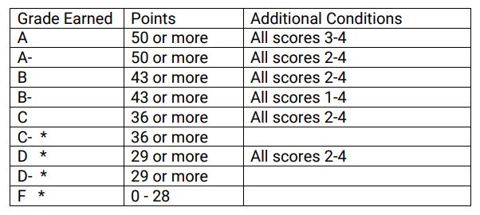
Final Assessment

Slide 30
Syllabus – Scholastic Conduct
I take scholastic conduct SERIOUSLY!
http://www.uni.edu/pres/policies/301.shtml
General rule
Discussing the ideas in a homework assignment is acceptable.
Copying code or answers is not.
Programming “next to each other” is not.
First and foremost, your final submission for any assignment should be your own individual, original work unless otherwise specified.
But here is the thing – my grading policies make cheating STUPID.

Slide 31
Questions at this point?

