Slide 1
Computational Thinking
With Mad Glibs

Slide 2
Looking at the schedule for next week
Notes:
And why is studying computer science important to our country?
One good reason is this is where the jobs are.
Here are [CLICK] national projections on STEM jobs in our country from the Bureau of Labor Statistics
This graph shows that out of all the NEW “STEM” jobs in our economy, more than 60% will be in computing related occupations

Slide 3
Unplugged Activity – Warm up!
I want you to sum up all of the numbers from 1 to 200.
In your head
In 30 Seconds.
GO!
Notes:
And why is studying computer science important to our country?
One good reason is this is where the jobs are.
Here are [CLICK] national projections on STEM jobs in our country from the Bureau of Labor Statistics
This graph shows that out of all the NEW “STEM” jobs in our economy, more than 60% will be in computing related occupations

Slide 4
Unplugged Activity – Warm up!
Did anyone think this was so hard they didn’t even try?
Did anyone attempt it but not finish?
Did anyone get an answer?
What DID you try?
Notes:
And why is studying computer science important to our country?
One good reason is this is where the jobs are.
Here are [CLICK] national projections on STEM jobs in our country from the Bureau of Labor Statistics
This graph shows that out of all the NEW “STEM” jobs in our economy, more than 60% will be in computing related occupations

Slide 5
Unplugged Activity – Warm up!
If we break the problem up into smaller pieces (decompose the problem), it becomes easier to manage.
What is 200 + 1
What is 199 + 2
What is 198 + 3
See a pattern?
What is our last pattern?
101 + 100
How many of these patterns are there?
100
Notes:
And why is studying computer science important to our country?
One good reason is this is where the jobs are.
Here are [CLICK] national projections on STEM jobs in our country from the Bureau of Labor Statistics
This graph shows that out of all the NEW “STEM” jobs in our economy, more than 60% will be in computing related occupations

Slide 6
Unplugged Activity – Warm up!
So adding up 1 to 200 is just
(1+200)*100 = 20100
Now that you know the pattern, could you add up all of the numbers from 1 to 2000? How about 1 to 20,000?
What stays the same in each of these new summations? What is different?
Notes:
And why is studying computer science important to our country?
One good reason is this is where the jobs are.
Here are [CLICK] national projections on STEM jobs in our country from the Bureau of Labor Statistics
This graph shows that out of all the NEW “STEM” jobs in our economy, more than 60% will be in computing related occupations

Slide 7
Unplugged Activity – Warm up!
Notes:
And why is studying computer science important to our country?
One good reason is this is where the jobs are.
Here are [CLICK] national projections on STEM jobs in our country from the Bureau of Labor Statistics
This graph shows that out of all the NEW “STEM” jobs in our economy, more than 60% will be in computing related occupations

Slide 8
Unplugged Activity – Warm up!
Notes:
And why is studying computer science important to our country?
One good reason is this is where the jobs are.
Here are [CLICK] national projections on STEM jobs in our country from the Bureau of Labor Statistics
This graph shows that out of all the NEW “STEM” jobs in our economy, more than 60% will be in computing related occupations

Slide 9
Unplugged Activity – Warm up!
What we have been doing is working with a special kind of algorithm. (What was the definition of an algorithm again?)
Notes:
And why is studying computer science important to our country?
One good reason is this is where the jobs are.
Here are [CLICK] national projections on STEM jobs in our country from the Bureau of Labor Statistics
This graph shows that out of all the NEW “STEM” jobs in our economy, more than 60% will be in computing related occupations

Slide 10
Unplugged Activity – Warm up!
Notes:
And why is studying computer science important to our country?
One good reason is this is where the jobs are.
Here are [CLICK] national projections on STEM jobs in our country from the Bureau of Labor Statistics
This graph shows that out of all the NEW “STEM” jobs in our economy, more than 60% will be in computing related occupations

Slide 11
Unplugged Activity – Warm up!
Notes:
And why is studying computer science important to our country?
One good reason is this is where the jobs are.
Here are [CLICK] national projections on STEM jobs in our country from the Bureau of Labor Statistics
This graph shows that out of all the NEW “STEM” jobs in our economy, more than 60% will be in computing related occupations

Slide 12
Unplugged Activity – Warm up!
What we have been doing is working with a special kind of algorithm. (What was the definition of an algorithm again?)
Abstraction – Pulling out specific differences to make one solution (algorithm) work for multiple problems.
If we assume that we are going to pass in a stopping value, let’s call it “number” what is the algorithm for this problem?
Notes:
And why is studying computer science important to our country?
One good reason is this is where the jobs are.
Here are [CLICK] national projections on STEM jobs in our country from the Bureau of Labor Statistics
This graph shows that out of all the NEW “STEM” jobs in our economy, more than 60% will be in computing related occupations

Slide 13
Unplugged Activity – Warm up!
To sum up all of the numbers from 1 to NUMBER:
Find (1+NUMBER)
Multiply this by (NUMBER/2)
The resulting product is the sum of the set of numbers!
Does this work? Test it for 200, 20, even 2.
Does it work for odd numbers such as 5?
Notes:
And why is studying computer science important to our country?
One good reason is this is where the jobs are.
Here are [CLICK] national projections on STEM jobs in our country from the Bureau of Labor Statistics
This graph shows that out of all the NEW “STEM” jobs in our economy, more than 60% will be in computing related occupations

Slide 14
Applying this Idea to Mad Glibs
In your notes or on some scratch paper
Number the first six lines
Line 1 – Ingredient (eg. Corn)
Line 2 – Ingredient
Line 3 – Liquid Ingredient (eg. Coconut Milk)
Line 4 – Ingredient
Line 5 – Ingredient
Line 6 – Finished recipe (eg. Enchilada)
Notes:
And why is studying computer science important to our country?
One good reason is this is where the jobs are.
Here are [CLICK] national projections on STEM jobs in our country from the Bureau of Labor Statistics
This graph shows that out of all the NEW “STEM” jobs in our economy, more than 60% will be in computing related occupations

Slide 15
Share your “recipe” with your table.
Line 1
Line 2
Line 3
Line 4
Line 2
Line 5
Line 6
Notes:
And why is studying computer science important to our country?
One good reason is this is where the jobs are.
Here are [CLICK] national projections on STEM jobs in our country from the Bureau of Labor Statistics
This graph shows that out of all the NEW “STEM” jobs in our economy, more than 60% will be in computing related occupations

Slide 16
Applying this idea to Mad Glibs
I remember this awesome Mad Glib we used to play, but I can’t find the original story.
But what I DO have is two copies of finished stories.
Using pattern matching and abstraction like we did in our warm up, I want you to figure out the original story template.
Notes:
And why is studying computer science important to our country?
One good reason is this is where the jobs are.
Here are [CLICK] national projections on STEM jobs in our country from the Bureau of Labor Statistics
This graph shows that out of all the NEW “STEM” jobs in our economy, more than 60% will be in computing related occupations

Slide 17
Applying this idea to Mad Glibs
Suggestions
Pattern match between each story by circling the sections of words that are identical from story to story
Abstract away the differences from each story by underlining words that change from story to story
Make a story template by writing up the circled parts and leaving the underlined sections as blanks
Examine the blanks and the game sheets to figure out how to fill in the blanks as the story is written.
Notes:
And why is studying computer science important to our country?
One good reason is this is where the jobs are.
Here are [CLICK] national projections on STEM jobs in our country from the Bureau of Labor Statistics
This graph shows that out of all the NEW “STEM” jobs in our economy, more than 60% will be in computing related occupations

Slide 18
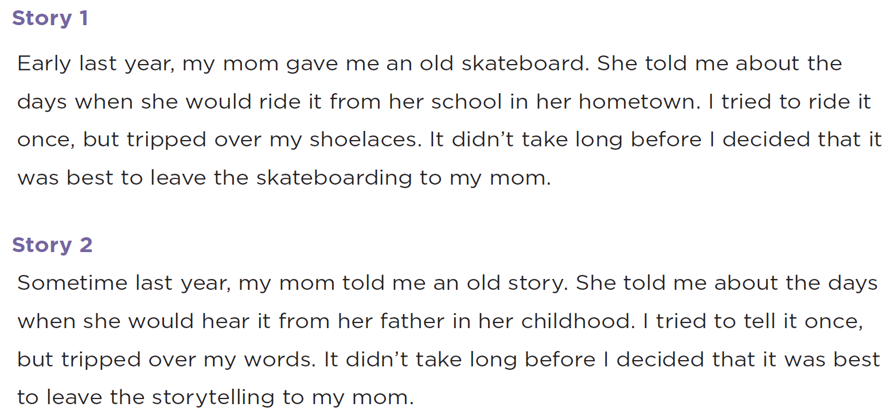

Slide 20
Wrap Up
What should you try to do when you’re asked to do something and you don’t know how?
If a problem is too hard, what should you try to do?
If you find similarities in lots of solutions to different problems, what does that probably tell you?
If you have a problem that is just a little different from a problem that you have a solution for, what would you do?
Notes:
And why is studying computer science important to our country?
One good reason is this is where the jobs are.
Here are [CLICK] national projections on STEM jobs in our country from the Bureau of Labor Statistics
This graph shows that out of all the NEW “STEM” jobs in our economy, more than 60% will be in computing related occupations

Slide 21
Debrief
What do you like about the lesson itself?
Where might your students struggle with this?
What might you try differently?
What additional activities could you do?
Notes:
And why is studying computer science important to our country?
One good reason is this is where the jobs are.
Here are [CLICK] national projections on STEM jobs in our country from the Bureau of Labor Statistics
This graph shows that out of all the NEW “STEM” jobs in our economy, more than 60% will be in computing related occupations

