Slide 1
Section 10.1 and 10.2

Slide 2
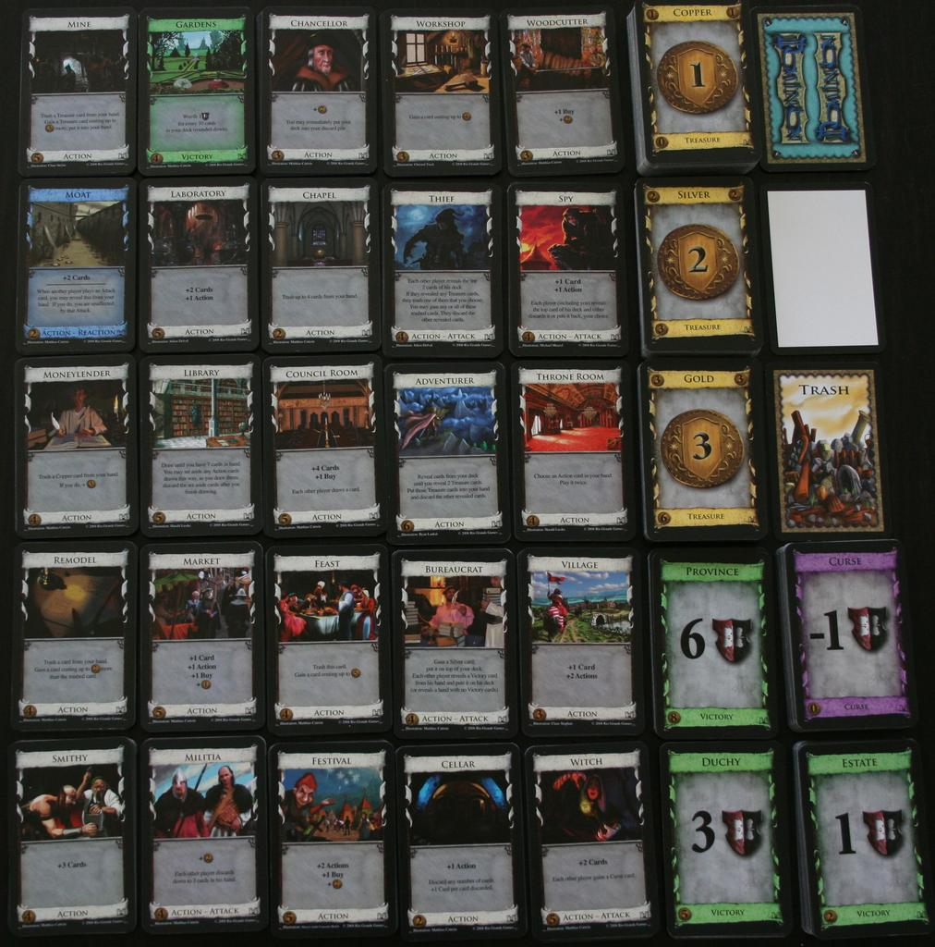
Dominion
There are 25 main card types that CAN be part of a game.
Each game uses 10 different cards.
My son wanted to know how long it would take us to play every card combination.
3.3 Million

Slide 3
Problem #1
Given the set A = {1, 2, 3}, what is the cardinality of P(A),where P denotes the power set?
What is the cardinality of P(B) if B = {a,b,c,d,e} ?
How many subsets of B have a cardinality of three?

Slide 4
Transition
All these problems connect with the material we will study next
Counting and Probability
Counting is the basis of an entire course:
Math 3530 Combinatorics
Catalog description: Various ways to enumerate elements of a set.

Slide 5
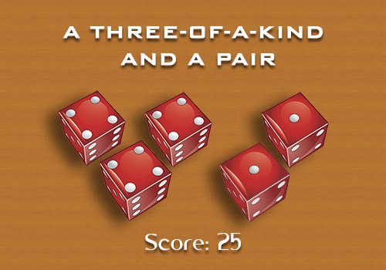
Activity 2
A “Full House” in the game Yahtzee is when you roll three dice with one number and two dice with a second number.

Slide 6
Activity 2
How many different “Full Houses” are possible?
In how many ways can you ROLL a Full House with one roll of five dice?

Slide 7
How many different “Full Houses” are possible?
This one is fairly easy:
There are six choices for the “three of a kind”
There are five choices for the “two of a kind”
6*5 = 30

Slide 8
In how many ways can you ROLL a Full House with one roll of five dice?
This is actually harder than I would expect you to be able to do right now.
We will come back to this one a little bit later.

Slide 9
The Product Rule
If you are finding ways to combine one element each from a sequence of sets (one of this AND one of this AND one of this…) the number of combinations is the product of the cardinality of each of the sets.

Slide 10
Activity #3
License Plates in Iowa contain three letters of the alphabet followed by three digits. How many license plates are possible? [Assuming all combos are legal]

Slide 11
The Sum Rule
If you are finding ways to select one element each from a sequence of sets (one of this OR one of this OR one of this…) the number of combinations is the sum of the cardinality of each of the sets.

Slide 12
Activity #4
John has room for one more class in his schedule.
He still needs to take a class from Written Communication and Quantitative Reasoning for UNIFI
WC {ENG 1005, ENG 2015, ENG 2120, PHIL 1050}
QR {ECON 1031, ECON 1041, FIN 1040, Math 1100, Math, 1160, Math 1204, Math 1420, PHIL 1030, SOCSCI 2020, Stat 1772}
In how many ways can he select a course for his schedule?

Slide 13
Activity #5
A password on a computer system consists of six, seven, or eight characters. Each of these characters must be a digit or a letter of the alphabet.
How many possible passwords exist?

Slide 14
The Bijection Rule - Background
Sometimes it is hard to calculate the exact number of elements in one set.
BUT if we can show that the given set has a bijection with another, countable set, then we can use that information to our advantage.

Slide 15
The Bijection Rule
A function f from a set S to a set T is called a bijection if and only if it has a well-defined inverse function.
That is, there must also be a mapping from T to S.

Slide 16
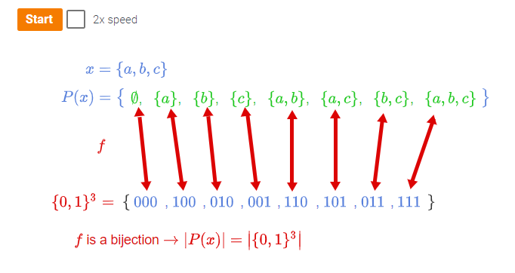

Slide 17
The K-to-1 Rule
Sometimes the function isn’t one-to-one but K-to-1.

Slide 18
Activity #6
I hand out Easter eggs to kids in my neighborhood. There are 12 eggs per box. Last year I needed five boxes.
How many eggs did I hand out?

