Slide 1
Section 3.1
The Joy of Sets

Slide 2
Activity 1
Define the following vocabulary terms
Set
Elements
Null set/empty set
Cardinality
Subset
Proper Subset
Venn Diagram
From your reading, what do you think is the most important thing to remember when considering sets?

Slide 3
Demonstrate Sets vs. Lists in Python

Slide 4
Activity 2
Translate the following set based mathematical statements into English
A = { 2, 3, 4}
B = { 2, 4, 3 }
C = ∅
2 ∈ A
A ⊆ B
A ⊂ B
C ⊂ B
| A | = 3

Slide 5
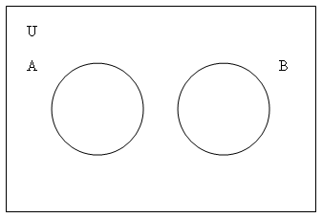
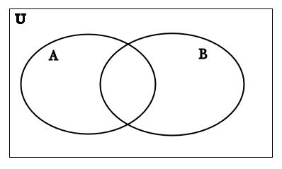
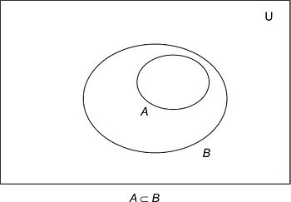
Activity 3
For each of the following Venn diagrams define sets A and B such that the image would be an accurate representation.

