Slide 1
Sections 3.2 and 3.3
Let’s Talk About Sets Baby
Let’s talk about Q and Z

Slide 2
Activity 1
Suppose that you can get a cheese pizza plain, or with any combination of the following toppings. How many different pizzas could you order?
{Anchovies, Black olives, Canadian bacon, Delicious pepperoni }

Slide 3
Reviewing Vocabulary
Set
Elements
Null set/empty set
Cardinality
Subset / Proper Subset

Slide 4
Set Notation
A = { 1, 2, 3, 4, 5 }
B = { 2, 4, 6, 8, 10}
C = { -3, -2, -1, 0, 1, 2, 3}

Slide 5
Set Notation
A = { 1, 2, 3, 4, 5 }
B = { 2, 4, 6, 8, 10}
C = { -3, -2, -1, 0, 1, 2, 3}
D = { 1, 2, 3, 4, 5, … }

Slide 6
Common Sets in Mathematics
Z The set of integers
R The real numbers
Q The rational numbers
Q+ The set of positive rational numbers
R- The set of negative real numbers
N The natural numbers (same as Z+)

Slide 7
Set Builder Notation
A = { x ∈ N | x<6 }
What is the truth set for this set in Set Builder notation?

Slide 8
Activity 2
B = { m ∈ Z | 3m >= m² }
C = { n ∈ Z | 8 mod n = 0 }
D = { x ∈ R | x² – 4x + 3 = 0}
F = { w ∈ R | w² = |w| }

Slide 9
Sets can include sets
G = { 8, 12, 15 }
H = { {8, 12, 15} , {14, 12} , {13, 10} }
I = { 1, 2, 3, {3}, {4, 5}, {6, 7} ,{8}, ∅ }

Slide 10
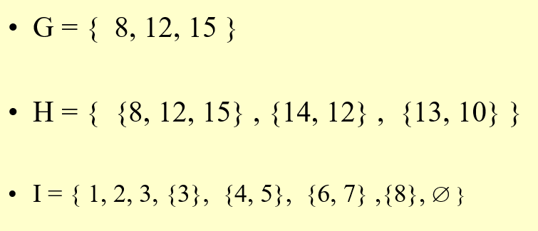
Activity 3
What is the cardinality of G?
What is the cardinality of H?
What is the cardinality of I?
8 ∈ G
8 ∈ H
8 ∈ I
{8} ∈ G
{8} ∈ H
{8} ∈ I
{8} ⊆ G
{8} ⊆ H
{8} ⊆ I

Slide 11
Power Set
The Power Set of set A (denoted by P(A)) is the set of all possible subsets of A.
A = {6, 7}
P(A) = { {6,7}, {6}, {7}, ∅ }

Slide 12
What does this have to do with?
Activity 1

Slide 13
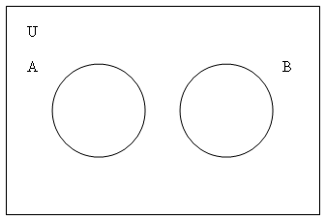
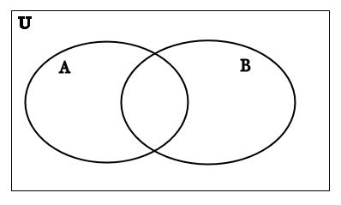
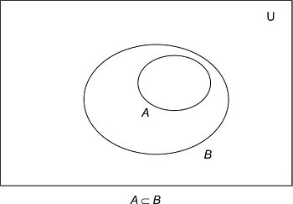
Activity #4
A = {even numbers} , B = {odd numbers}
A = {prime numbers} , B = {odd numbers}
A = {numbers divisible by 4}, B = {even numbers}
A = {students in this discrete class} , B = {students in data structures}
A = { students in this discrete class }, B = {students in Networking}
A = { students in this discrete class }, B = {students at UNI}

Slide 14
Common Set Operations
Intersection A ∩ B
Union
A ∪ B

Slide 15
Activity #5
Assume
A = { letters in the word ELEPHANT }
B = { letters in the word SYNCHOPHANT }
C = {letters in the word FANTASTIC}
D = {letters in the word STUDENT}
If the universe U is the set of 26 capital letters find:
A ∪ B
A ∩ B
A ∩ C
D ∪ A
(A ∩ C ) ∪ (B ∩ D)
A ∩ (C ∩ D)

