Slide 1
Section 3.4
More Set Operators

Slide 2
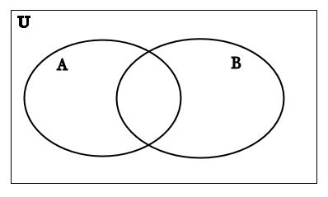
Common Set Operations
Intersection A ∩ B
Union
A ∪ B

Slide 3
Activity
Assume
A = { letters in the word ELEPHANT }
B = { letters in the word SYNCHOPHANT }
C = {letters in the word FANTASTIC}
D = {letters in the word STUDENT}
If the universe U is the set of 26 capital letters find:
A ∪ B
A ∩ B
A ∩ C
D ∪ A
(A ∩ C ) ∪ (B ∩ D)
A ∩ (C ∩ D)

Slide 4
Additional Set Operations
Difference
A – B
B – A
Symmetric Difference
A ⊕ B
B ⊕ A
Complement
A on my slides and handouts I will use A^{c}

Slide 5
Activity
Write in words how to read each of the following out loud. Then write the shorthand notation for each set.
{x ∈ U | x ∈ A and x ∈ B }
{x ∈ U | x ∈ A or x ∈ B }
{x ∈ U | x ∈ A and x ∉ B }
{x ∈ U | x ∉ A}

Slide 6
Activity
Let :
A = { 1,3,5,7,9}
B = { 3,6,9 }
U = {x ∈ Z | 0<x<10 }
Find the following
A ∪ B
A ∩ B
A ∪ U
A ∩ U
A – B
A^{c}
B^{c}

Slide 7
Activity
Complete the following sentences without using the symbols ∩, ∪, and -.
x ∉ (A ∩ B) if, and only if, …
x ∉ (A ∪ B) if, and only if, …
x ∉ (A – B ) if, and only if, …

Slide 8
Activity
Consider the following sets:
U = set of all students at UNI
S = set of all students with majors in CHAS
C = set of all computer science majors
P = set of all physics majors
F = set of all female students at UNI
What would the Venn diagram for these sets look like?

Slide 9
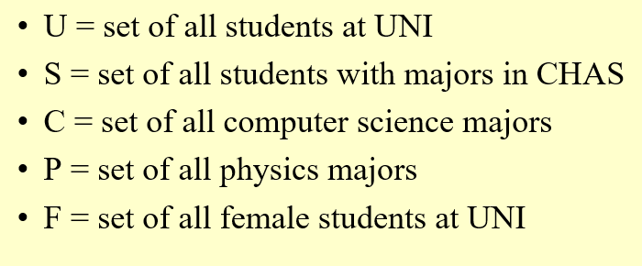
Activity
Write an expression using these sets and the set operations to express the following:
The set of people majoring in either computer science or physics.
The set of people majoring in both computer science and physics.
The set of computer science majors who are women.
The set of people who do not have a major in CHAS.
The set of male students who are majoring in both computer science and physics.
The set of female physics students and male computer science students.

