Slide 1
Section 4.5

Slide 2
Review
Give me an example of a relation that is:
A bijective function.
An injective (one-to-one) function only.
A surjective (onto) function only.
A function, but neither 1-to-1 or onto.
Not a function.

Slide 3
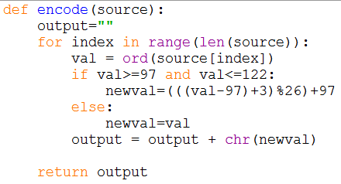
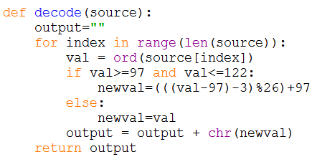
Activity 1
Look at the following code. What does it do?

Slide 4
Discussion
What happens in this line of code?
What is the domain of len()?
What is the target of len()?
What is the domain of range()?
What is the target of range()?

Slide 5
Composition of Functions
Suppose we have two functions
d: A→B
e: B→C
We denote the composition of d and e as
e ◦ d
read e circle d

Slide 6
Composition of Functions
Suppose we have two functions
d: A→B
e: B→C
We define the composition by
e ◦ d (x) = e(d(x)) read e of d of x

Slide 7
Composition of Functions
What has to be true about d and e for
e ◦ d (x) = e(d(x))
To be definable?

Slide 8
Activity #2
Let
A = {a, b, c}
B = {1, 2, 3}
d is defined as {(a,b), (b,c), (c,a)}
e is defined as {(a,3), (b,2), (c,1)}
Draw an arrow diagram for each of these functions.

Slide 9
Activity #2
What is e ◦ d (the composition of e and d)
{(a,2), (b,1), (c,3)}

Slide 10
Activity #2
What is d ◦ e (the composition of d and e)
Not defined since the range of e is not a subset of the domain of d.

Slide 11
Activity #3
Let
f: R→R and g: R→R
f(x) = 2x + 3 g(x) = 3x + 2
What is f ◦ g (2), f ◦ g (-3), f ◦ g (x)?

Slide 12
Activity #3
Let
f: R→R and g: R→R
f(x) = 2x + 3 g(x) = 3x + 2
Can we do g◦f (x)?
If so, what is it? If not, why not?

Slide 13
What happens if?
f: R→R
f ⁻¹: R→R
What is f ⁻¹ ◦ f
What is f ◦ f ⁻¹
f ⁻¹ ◦ f = f ◦ f ⁻¹ = I_{f}

Slide 14
What happens if?
f: R→R
What is I_{f}◦ f
What is f ◦ I_{f}
I_{f}◦ f = f ◦ I_{f} = f

Slide 15
What happens if?
f: R→R
g: R→R
Both f and g are one-to-one functions
Is g ◦ f a one-to-one function?

Slide 16
What happens if?
f: R→R
g: R→R
Both f and g are onto functions
Is g ◦ f an onto function?

Slide 17
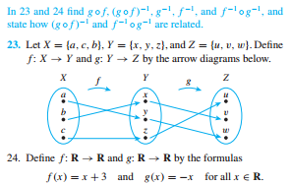
Activity #4

