Slide 1
Section 13.1 and 13.2
Graphs

Slide 2
REVIEW - What are “Graphs”
Graphs are fundamental objects in discrete mathematics that model relationships between pairs of objects.

Slide 3
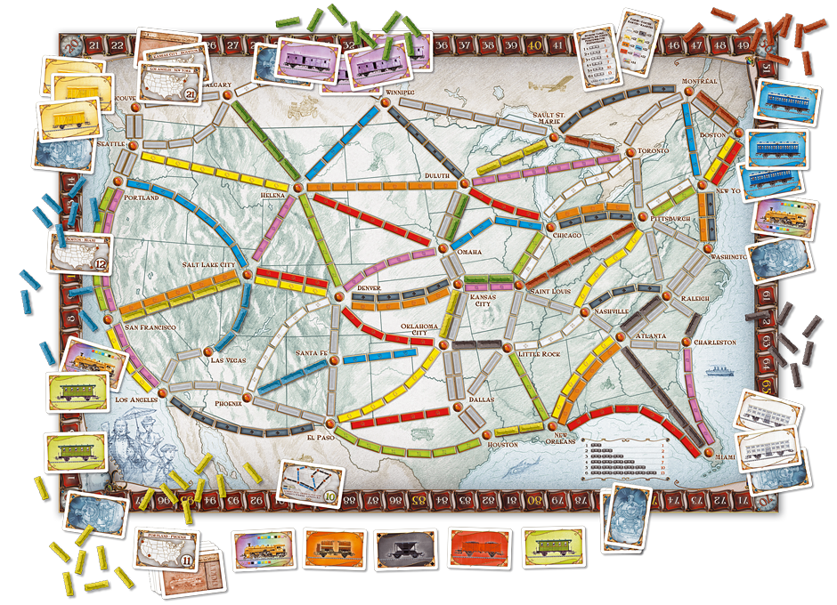

Slide 4
Examples
- Roadmaps
- Communication networks
- WWW
- Electrical circuits
Task schedules
Facebook friends

Slide 5
Graphs – Definitions
Vertex / Vertices
Edge(s)
Directed Graph
Undirected Graph
Parallel Edge
Self Loop
Adjacent
Endpoints
Incident
Neighbor
Degree
Total Degree
Regular Graph
Subgraph

Slide 6
Graphs – Definitions
Vertex / Vertices
Edge(s)
Directed Graph
Undirected Graph

Slide 7
Graphs — an overview
labelled vertices
BOS
DTW
SFO
PIT
JFK
LAX

Slide 8
Graphs — an overview
labelled vertices
BOS
DTW
SFO
PIT
JFK
LAX
undirected
edges

Slide 9
Graphs — an overview
labelled vertices
618
BOS
DTW
SFO
2273
211
190
PIT
318
344
1987
JFK
2145
LAX
2462
labelled edges

Slide 10
Graphs — an overview
labelled vertices
BOS
DTW
SFO
PIT
JFK
LAX
directed edges

Slide 11
Introduction: Formal Definition
A graph G = (V,E) consists of a finite set of vertices, V, and a finite set of edges E.
Each edge is a pair (v,w) where v, w ∈ V

Slide 12
Introduction: Formal Definition
A directed graph, or digraph, is a graph in which the edges are ordered pairs
(v, w) ≠ (w, v)
An undirected graph is a graph in which the edges are unordered pairs
(v, w) == (w, v)

Slide 13
Graph A

Slide 14
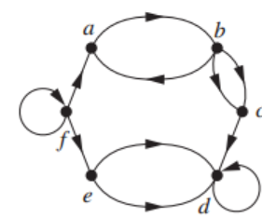
Graph B

Slide 15
Introduction: Formal Definition
Write the Formal Definition for graphs A and B:
A graph G = (V,E) consists of a finite set of vertices, V, and a finite set of edges E.
Each edge is a pair (v,w) where v, w ∈ V

Slide 16
Graphs – Definitions
Vertex / Vertices
Edge(s)
Directed Graph
Undirected Graph
Parallel Edge
Self Loop
Adjacent
Endpoints
Incident
Neighbor

Slide 17
Graphs – Definitions
Vertex / Vertices
Edge(s)
Directed Graph
Undirected Graph
Parallel Edge
Self Loop
Adjacent
Endpoints
Incident
Neighbor
Degree
Total Degree

Slide 18
Degrees
- directed
out-degree of x: the number of edges (x,y)
in-degree of x: the number of edges (y,x)
degree: sum of in-degree and out-degree
- undirected
degree of x: the number of edges {x,y}
Degrees are often important in determining the running time of an algorithm.

Slide 19
Graph Representation on the Computer
Adjacency List
Matrix

Slide 20
Adjacency List Representation

Slide 21
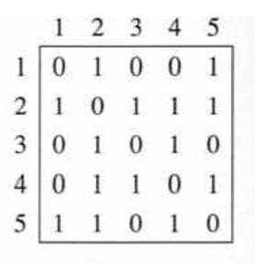
Matrix

Slide 22
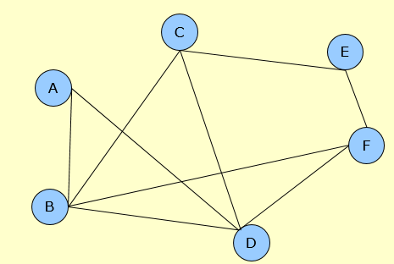
Activity #3
Adjacency List
Matrix

Slide 24
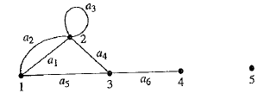
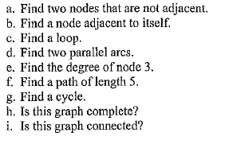
Activity 4

