Slide 1
Section 4.4 and 4.5

Slide 2
Image and Inverse Image
If f(x)=y then we say that
The image of x is y
The inverse image (pre-image) of y is x

Slide 3
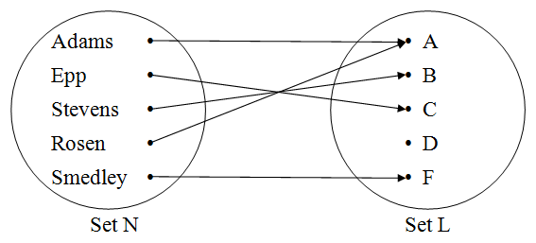
Activity #1
What is the image of Adams?
What is the image of Epp?
What is the inverse image of B?
What is the inverse image of A?

Slide 4
The inverse of a function
The inverse of function f is noted as f⁻¹
f⁻¹ ^{={ (b,a) : (a,b) ∈ f }}
If f = { (1,square), (2,circle), (3,triangle) }
What is f⁻¹

Slide 5
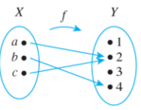
Activity #2
Let
f: X → Y as shown by :
g: R→R g(x) = 2x + 3
h: R→R h(x) = x² + 4
Find the inverse of each of these functions.

Slide 6
Is the inverse function really a function?
You identified three inverses in Activity #2.
Which of these were actually inverse functions?

Slide 7
What kinds of functions produce inverse functions?
What is the definition of a function?
How does this effect whether or not a function has an inverse?

Slide 8
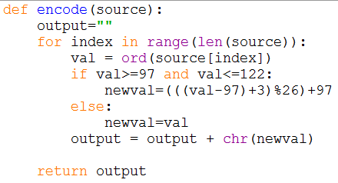
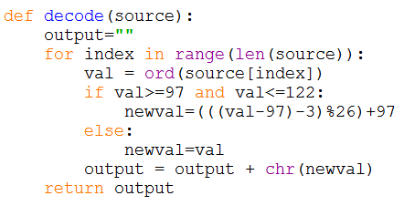
Activity 3
Look at the following code. What does it do?

Slide 9
Discussion
What happens in this line of code?
What is the domain of len()?
What is the target of len()?
What is the domain of range()?
What is the target of range()?

Slide 10
Composition of Functions
Suppose we have two functions
d: A→B
e: B→C
We denote the composition of d and e as
e ◦ d
read e circle d

Slide 11
Composition of Functions
Suppose we have two functions
d: A→B
e: B→C
We define the composition by
e ◦ d (x) = e(d(x)) read e of d of x

Slide 12
Composition of Functions
What has to be true about d and e for
e ◦ d (x) = e(d(x))
To be definable?

Slide 13
Activity #4
Let
A = {a, b, c}
B = {1, 2, 3}
d is defined as {(a,b), (b,c), (c,a)}
e is defined as {(a,3), (b,2), (c,1)}
Draw an arrow diagram for each of these functions.

Slide 14
Activity #4
What is e ◦ d (the composition of e and d)
{(a,2), (b,1), (c,3)}

Slide 15
Activity #4
What is d ◦ e (the composition of d and e)
Not defined since the range of e is not a subset of the domain of d.

Slide 16
Activity #5
Let
f: R→R and g: R→R
f(x) = 2x + 3 g(x) = 3x + 2
What is f ◦ g (2), f ◦ g (-3), f ◦ g (x)?

Slide 17
Activity #5
Let
f: R→R and g: R→R
f(x) = 2x + 3 g(x) = 3x + 2
Can we do g◦f (x)?
If so, what is it? If not, why not?

Slide 18
What happens if?
f: R→R
f ⁻¹: R→R
What is f ⁻¹ ◦ f
What is f ◦ f ⁻¹
f ⁻¹ ◦ f = f ◦ f ⁻¹ = I_{f}

Slide 19
What happens if?
f: R→R
What is I_{f}◦ f
What is f ◦ I_{f}
I_{f}◦ f = f ◦ I_{f} = f

Slide 20
What happens if?
f: R→R
g: R→R
Both f and g are one-to-one functions
Is g ◦ f a one-to-one function?

Slide 21
What happens if?
f: R→R
g: R→R
Both f and g are onto functions
Is g ◦ f an onto function?

Slide 22
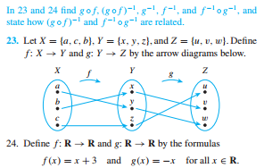
If time

