Slide 1
Chapter 7
Algorithm Analysis

Slide 2
From last time
Write an algorithm in pseudocode for the following input and output.
Input: a₁, a₂,...,a_{n}, a sequence of numbers, where n ≥ 2 n, the length of the sequence.
Output: The second smallest number in the sequence

Slide 3
What I want you to know
This chapter is about Computational Complexity.
What does that mean?
There are two types of complexity that a computer scientist might study:
Time Complexity
Space Complexity

Slide 4
Determining f() for a function
What is f()?

Slide 5
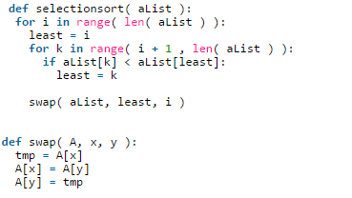
Estimate f() for …

Slide 6
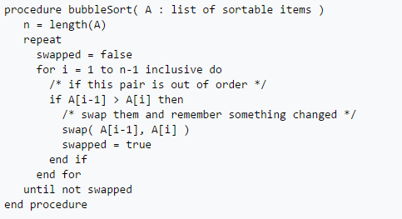
Estimate f() for …

Slide 7
Vocabulary
Big-Oh
Omega
Theta

Slide 8
Big-Oh Notation
There is a ton of stuff in section 7.2 about Big-Oh (or just “Oh”) notation.
Most of it’s confusing and irrelevant
What it really boils down to is:
Identify the factor with the largest growth
Throw away all the other terms
Ignore the Constant Factors

Slide 9
Additional Vocabulary
Constant Factors?
What were these?
3n versus 2n
We typically ignore the constant factors?
Why?
Because we aren’t really interested in ACTUAL time but instead in the “growth rate”

Slide 10
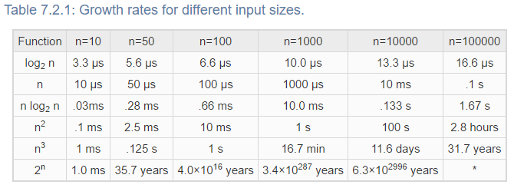

Slide 11
Consider the following
An algorithm has a runtime that calculates out to be:
f(n) = 2n³ + 4n² + 7
Let’s evaluate the function for a couple of different values of n.

Slide 12
What do I want you to be able to do?
Read an algorithm and give me a reasonable approximation of it’s f()
Read an algorithm and give me it’s Big-Oh.
Be given an f() for an algorithm and identify it’s Big-Oh.
Understand the “order” of the “growth terms”

