Slide 1
Exam Review
Networking
CS 3470, Section 1
Sarah Diesburg

Slide 2
Coverage
Total: 80 raw points
Based on lectures, assignments, and projects
Based on your ability to apply various principles learned in the class
Multiple choice, short answer, and problem solving questions
Percentage of points earned will be multiplied to percentage of 200 points as stated on syllabus

Slide 3
Coverage
Two parts
Chapters 5-6 (last third of class)
Roughly 2/3 of test
Cumulative (over first 2/3 of class, exams 1-2)
Roughly 1/3 of test

Slide 4
Chapters 5-6
Review

Slide 5
Transport Layer
Definitions
Transport layer
What is the primary function?
Why is it necessary (say on top of IP)?
Packet Encapsulation
Layer headers are added or taken away
Multiplexing/demultiplexing

Slide 6
Transport Layer
Definitions
Well-known ports
Pseudoheader
Flow control
Congestion control
Segments
Packets exchanged between TCP peers
TCP flags
SYN, ACK, FIN, RST

Slide 7
Transport Layer
Short answer / problem solving
UDP advantages over TCP
TCP advantages over UDP
Checksum with 1’s compliment
Why are the client port numbers random and high?

Slide 8
DNS
Definitions
What is DNS?
Host aliasing
Multiple names for one server
MX records
Load balancing
Many IP addresses associated with a hostname
Canonical name

Slide 9
DNS
Short answers / problem solving
Role of a root DNS server
Role of a top-level domain (TLD) server
Be able to create and identify iterative and recursive DNS queries
Role of DHCP and DNS

Slide 10
TCP Control Flow
Definitions
Sequence number field (often called SequenceNum)
Passive open
Active open
Maximum Segment Lifetime (TCP)

Slide 11
TCP Control Flow
Short answers / problem solving
TCP 3-way handshake
Goals of TCP sliding window
AdvertisedWindow/EffectiveWindow (see next slide)
TCP tear down sequence

Slide 12
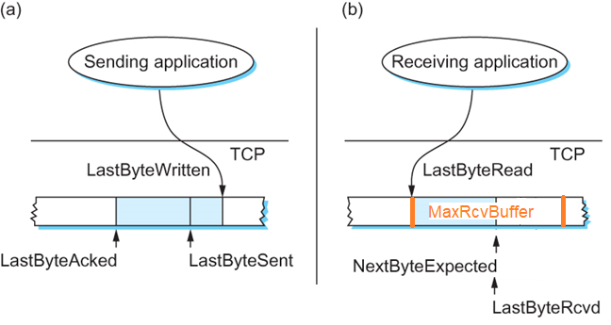
Sliding Window Revisited
Sender
Receiver
Be able to look at a sliding window diagram and show me the AdvertisedWindow (on receiver) and EffectiveWindow (on sender)

Slide 13
TCP Transmission Control
Definitions
Silly window syndrome
Fast retransmit (3 duplicate ACKs)
Nagle’s Algorithm
Generally, what does it do?
Adaptive Retransmission
Generally, what does it do?

Slide 14
TCP Transmission Control
Short answer / problem solving
3 ways TCP triggers a transmission
MSS
Explicit send
Timer
TCP cumulative ACKs

Slide 15
TCP Congestion Control
Definitions
Congestion window (or CongWin)
TCP loss event
Why do we care about losses?
Timeout or 3 duplicate ACKs
Additive Increase/Multiplicative Decrease (AIMD)
Slow Start
Fast Recovery

Slide 16
TCP Congestion Control
Short answers / problem solving
Explain how AIMD and slow start work
Explain how fast recovery works
Explain how TCP is fair
Is all traffic fair, including UDP?
Homework 8, questions 3-4

Slide 17
Summary: TCP Congestion Control
When CongWin is below Threshold, sender in slow-start phase, window grows exponentially.
When CongWin is above Threshold, sender is in congestion-avoidance phase, window grows linearly.
When a triple duplicate ACK occurs, Threshold set to CongWin/2 and CongWin set to Threshold.
When timeout occurs, Threshold set to CongWin/2 and CongWin is set to 1 MSS.

Slide 18
Programming Project
What does a pipe (“|”) and redirection (“>” or “<“) do?

Slide 19
Putting it all together
Review

Slide 20
Putting it all together
Wireshark
I may paste a screenshot of a Wireshark trace and ask you a few questions about it
Review project 5 to prepare

Slide 21
Putting it all together
Definitions
Review definitions and general concepts from previous reviews and old tests

Slide 22
Putting it all together
The following problem-solving questions may show up on the final from previous tests:
Calculate the total time required to transfer a file (recall the definition of latency)
NRZ, Manchester, and NRZI encodings
2-Dimensional Parity

Slide 23
Putting it all together
Drawing windows in the sliding window protocol
ISO/OSI vs Internet Model
Determining next hop for a CIDR network
Dijkstra's algorithm
Spanning tree
Creating subnets

